Slide 1
Your First CW QSO What You Need To Know
Bob Karz, K2OID
December 18, 2018

Slide 2
The Band Plan – Where are the CW Stations?
Hint – They’re RED

Slide 3
The Band Plan – Where are the CW Stations?

Slide 4
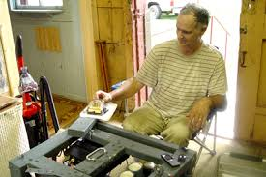
The Band Plan – Where are the CW Stations?
Look Towards the Top of the CW Sub-band
Typically 50 to about 70 Khz above band edge
Slowest CW
Less QRM
Stay below the unofficial Data frequencies (RTTY, FT8, etc.)

Slide 5
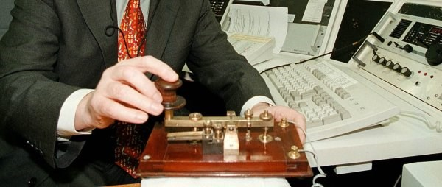
How to Initiate a Contact
CQ CQ CQ CQ DE W2XYZ W2XYZ K
Number of repeats is up to the operator
Answer at calling station’s speed or slower
Not Faster
Send his/her call once “DE” your call twice then “K”
If you call the CQ, first send “QRZ DE K2OID” to be sure the frequency is clear
I suggest CQ CQ CQ DE K2OID repeated twice then “K”
Ideally you want only 1 answer

Slide 6
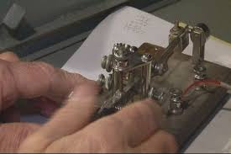
The Initial Exchanges
The call:
CQ CQ CQ DE W2XYZ K
My Answer:
W2XYZ DE K2OID K2OID K
His/Her reply:
K2OID DE W2XYZ – RR ES TNX FER THE CALL – UR RST IS 569 569 ES QTH IS NR BINGHAMTON, NY NR BINGHAMTON, NY - NAME IS GEORGE GEORGE – SO HW? AR K2OID DE W2XYZ K

Slide 7
OK. I recognize some of this. What does it mean in English?

Slide 8
The Initial Exchanges
Anyone want a contact?
From
Back to you
The call:
CQ CQ CQ DE W2XYZ K
My Answer:
W2XYZ DE K2OID K2OID K
His/Her reply:
K2OID DE W2XYZ – RR ES TNX FER THE CALL – UR RST IS 569 569 ES QTH IS NR BINGHAMTON, NY NR BINGHAMTON, NY - NAME IS GEORGE GEORGE – SO HW? AR K2OID DE W2XYZ K
Roger Roger and thanks for
your
Signal Report
Location
near
That’s it for
this go around
and
how copy

Slide 9
The Initial Exchanges
You repeat your call twice in your first call as insurance that the other station has your call correct.
The call:
CQ CQ CQ DE W2XYZ K
My Answer:
W2XYZ DE K2OID K2OID K
His/Her reply:
K2OID DE W2XYZ – RR ES TNX FER THE CALL – UR RST IS 569 569 ES QTH IS NR BINGHAMTON, NY NR BINGHAMTON, NY - NAME IS GEORGE GEORGE – SO HW? AR K2OID DE W2XYZ K
Note that dashes are used in place of periods to separate “sections”

Slide 10
The Initial Exchanges
The call:
CQ CQ CQ DE W2XYZ K
My Answer:
W2XYZ DE K2OID K2OID K
His/Her reply:
K2OID DE W2XYZ – RR ES TNX FER THE CALL – UR RST IS 569 569 ES QTH IS NR BINGHAMTON, NY NR BINGHAMTON, NY - NAME IS GEORGE GEORGE – SO HW? AR K2OID DE W2XYZ K
He/She sends K2OID DE W2XYZ so that:
You know he/she has your call correct
That W2XYZ is actually in QSO with you, not someone else

Slide 11
The Initial Exchanges
Before anything else you will hear your signal report sent twice because he/she has no idea how well you are copying his/her signal
The call:
CQ CQ CQ DE W2XYZ K
My Answer:
W2XYZ DE K2OID K2OID K
His/Her reply:
K2OID DE W2XYZ – RR ES TNX FER THE CALL – UR RST IS 569 569 ES QTH IS NR BINGHAMTON, NY NR BINGHAMTON, NY - NAME IS GEORGE GEORGE – SO HW? AR K2OID DE W2XYZ K

Slide 12
Interpreting the QSO so far
The Signal Report or RST
Readability (Scale from 1 – 5)
Most of the time it will be “5” (perfectly readable)
4 means some difficulty (perhaps interference (QRM) or static/noise (QRN)
3 (rare) means significant difficult
2 (even more rare) means barely copyable
1 means no copy
Strength (Scale from 1 – 9)
More or less follows your S-Meter reading
I give 9 to very strong signals, 7 or 8 to strong signals, 5 or 6 to average signals, 3 or 4 to weak signals, and 1 or 2 to very weak signals

Slide 13
Interpreting the QSO so far
Strength (Scale from 1 – 9) Cont’d
Be honest about strength, don’t just repeat what the other station sends
In contests most stations just send “599” as in:
UR 599 – PSE RPT ALL
Besides QRN and QRM, a common “add” is QSB or signal fading e.g. 599QSB
If there is QSB, I give a signal report based on the strongest it has been
Tone (Scale from 1 – 9)
This is a hold over from the spark and vacuum tube days. It should be 9 unless the other signal is truly bad (e.g. 60 Hz hum or chirp)

Slide 14
The Initial Exchanges
QTH and Name
After the RST, the QTH is sent first
I generally send “NR ROCHESTER, NY” twice
Your name is the final information on the first exchange (again sent twice)
Note that many stations have computers with QRZ.com, so they have your information
The call:
CQ CQ CQ DE W2XYZ K
My Answer:
W2XYZ DE K2OID K2OID K
His/Her reply:
K2OID DE W2XYZ – RR ES TNX FER THE CALL – UR RST IS 569 569 ES QTH IS NR BINGHAMTON, NY NR BINGHAMTON, NY - NAME IS GEORGE GEORGE – SO HW? AR K2OID DE W2XYZ K

Slide 15
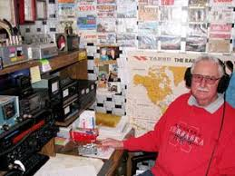
The Initial Exchanges
Your typical response
W2XYZ DE K2OID – FB GEORGE – NICE TO MEET U – UR RST IS 579 579 ES QTH IS NR ROCHESTER, NY NR ROCHESTER, NY - NAME IS BOB BOB – RIG HR IS FLEX 6300 AT 100 W TO A DIPOLE AT 50 FT – WX IS CLDY WID SNOW - HW? AR W2XYZ DE K2OID K

Slide 16
The Initial Exchanges
fine business
watts
you
Your typical response
W2XYZ DE K2OID – FB GEORGE – NICE TO MEET U – UR RST IS 579 579 ES QTH IS NR ROCHESTER, NY NR ROCHESTER, NY - NAME IS BOB BOB – RIG HR IS FLEX 6300 AT 100 W TO A DIPOLE AT 50 FT – WX IS CLDY WID SNOW – TEMP IS 28F - HW? AR W2XYZ DE K2OID K
here
weather
cloudy with
temperature

Slide 17
The Initial Exchanges
Your typical response
W2XYZ DE K2OID – FB GEORGE – NICE TO MEET U – UR RST IS 579 579 ES QTH IS NR ROCHESTER, NY NR ROCHESTER, NY - NAME IS BOB BOB – RIG HR IS FLEX 6300 AT 100 W TO A DIPOLE AT 50 FT – WX IS CLDY WID SNOW - HW? AR W2XYZ DE K2OID K
His/Her typical reply
His rig
His weather
Perhaps a question or comment for your response

Slide 18
The Initial Exchanges
Some possible rag chew topics
How long a ham
Age
Equipment
Been to your QTH
Some QSOs are very short while others can last hours

Slide 19
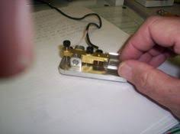
Hints and Tips
Always begin your transmission with feedback on copy For example:
FB GEORGE – SOLID COPY
QRM TT TIME BUT GOT MOST
QTH AGN PSE BK
If the other station is sending too fast for you don’t hesitate to QRS For example:
I AM NEW TO CW – PSE QRS
Abbreviations are optional!!!

Slide 20
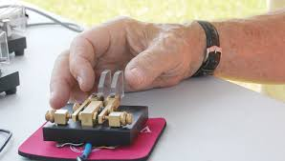
Hints and Tips
Never hesitate to have something you missed repeated.
Remember that you are in the low speed sub-band.
It is expected that less experienced CW ops (“not show offs”) will be found there.
Dashes (-) are often used in place of other punctuation

Slide 21
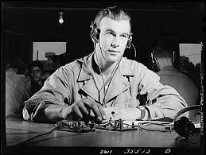
Hints and Tips
Signing “KN” rather than “K” means “no breakers”
Used most often during rag chew with DX or a rare state
Otherwise you are welcomed to “break in” between exchanges
Useful when going after that “new one”

Slide 22
Tying the Ribbon
When it’s involuntary (e.g. QRN, QRM, QSB)
On your turn say some thing similar to: SRI – NO CPY CUZ QRM – 73 ES TNX QSO – HPE CU AGN – SK W2XYZ DE K2OID CL
When you have other commitments, say so:
XYL CLG ME TO DINNER
MUST CATCH SOME ZZ
More commonly:
TT IS ALL FROM HR – QRU?

Slide 23
Tying the Ribbon
This is my last transmission
(also “Silent Key” e.g. deceased)
Sorry – no copy because of QRM
When it’s involuntary (e.g. QRN, QRM, QSB)
On your turn say some thing similar to: SRI – NO CPY CUZ QRM – 73 ES TNX QSO – HPE CU AGN – SK W2XYZ DE K2OID CL
When you have other commitments, say so:
XYL CLG ME TO DINNER
MUST CATCH SOME ZZ
More commonly:
TT IS ALL FROM HR – QRU?
Wife calling
Thanks for the contact – Hope to see you again
Sleep
Station is closing down (or clear for this QSO)
That’s all from here – do you have anything more for me?

Slide 24
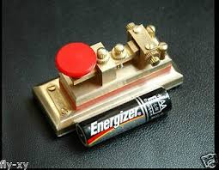
Confirming a contact (QSL)
If you want a confirmation (or QSL) now is the time to ask for it. For example:
PSE QSL or PSE QSL VIA BURO
Answer will probably be QSL SURE
Note: QSL also means “I heard you”, more or less synonymous with RR. “QSL?” means “did you copy what I just sent?”

Slide 25
Confirming a contact (QSL)
If you want a confirmation (or QSL) now is the time to ask for it. For example:
PSE QSL or PSE QSL VIA BURO
Answer will probably be QSL SURE
Note: QSL also means “I heard you”, more or less synonymous with RR. “QSL?” means “did you copy what I just sent?”
ARRL QSL Bureau
Please

Slide 26
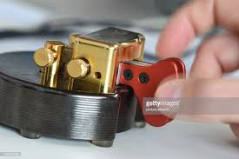
The Final Exchange
The final exchange for both sides ends with an “SK” then the call signs and finally “CL”. For example:
TNX NICE QSO – GE – SK AR W2XYZ DE K2OID CL

Slide 27
The Final Exchange
The final exchange for both sides ends with an “SK” then the call signs and finally “CL”. For example:
TNX NICE QSO – GE – SK AR W2XYZ DE K2OID CL
Good evening

Slide 28
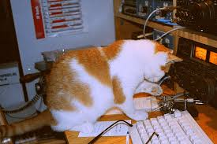
…But wait! There’s More
Final flourishes
After the “final” transmissions (the CLs) there is often a “CW goodbye handshake” without call signs
Technically against the rules but everyone does it
Example:
GE BOB E E (two spaced dits)
GE GEORGE E E

Slide 29
Final Remarks
CW is really both a shorthand and a language
For us English speakers it is relatively easy to master
It has English syntax
Most abbreviations are of English origin
Once you get on the air, you will quickly pick up the way things work
You’ll see why many of us think of it as the most elegant and enjoyable operating mode

Slide 30
CW Abbreviations
Below are some CW abbreviations that I use
73 Best Regards
88 Love & Kisses
A Number 1
ABT About
AGN Again
ANT Antenna
B4 Before
BCNU Be Seeing You
BK Back or Break
BURO QSL Bureau
CL Closing Station Down (or Clear in final transmission)
CLDY Cloudy
CLR Clear
CONDX Conditions
CONGRATS Congratulations

Slide 31
Common CW Abbreviations
CPY Copy
CQ General Call for a QSO (Contact)
CUZ Because
DE From (eg... W3AA de W3DF)
DSW See You Again (Russian)
DWN Down
DX Long Distance Contact, or a Rare Station
EL Element (as in 3 EL Yagi)
ES And
FB Fine Business (Ham jargon for very good)
FD Field Day
FER For
FIST Unique characteristic of an operator’s sending of CW
FONE Phone (as in AM or SSB)
FM From or Frequency Modulation
FREQ Frequency
GA Good Afternoon or Go Ahead

Slide 32
Common CW Abbreviations
GB Good Bye
GD Good or Good Day GE Good Evening GG Going
GL Good luck GM Good Morning GMT Greenwich Mean Time (standard time used by hams) GN Good Night GND Ground GP Ground Plane GUD Good HAM Amateur Radio Operator HI HI Laughter on CW HNY Happy New Year HPE Hope HR Here

Slide 33
Common CW Abbreviations
HV Have HW, HW? How, or How Do You Copy Me? II, II II II Error K Please Transmit KN Only the station I am working should transmit KNW Know LID Poor Operator Don’t confuse with “SOLID” LP Log Periodic (type of directional antenna) or Long Path LSB Lower Sideband LW Long Wire (type of antenna) MGR QSL Manager MNI, MANI Many MSG Message MULT Multiplier N No or the number 9. (599 IS 5NN IN MORSE) NIL Nothing Heard or No Copy

Slide 34
Common CW Abbreviations
NW Now OM Old Man (Ham jargon for an experienced operator) OP Operator, or Name OPR Operator or Operate PSE Please PWR Power QRL The frequency is busy Is the frequency busy? QRM Your transmission is being interfered with. Is my transmission being interfered with? QRN I am troubled by static. Are you troubled by static? QRO Increase power. Should I increase power? QRP Decrease power. Also a station using low power Should I decrease power? QRQ Send faster. Should I send faster? QRS Send slower. Should I send slower? QRT Stop transmitting. Should I stop transmitting?

Slide 35
Common CW Abbreviations
QRU I don’t have anything more. Do you have anything more? QRV I am ready. Are you ready? QRX Please standby for ... Should I standby? QRZ You are being called by ... Who is calling me? QSB Your signal is fading Is my signal fading? QSK I can operate break-in Can you operate break-in? QSL I acknowledge receipt Do you acknowledge receipt? QSO I can communicate with ... Can you communicate with ...?
QSY I will change my transmit frequency Should I change my transmit frequency?
QTH My location is ... What is your location?
R, RR Message Received or Correct, or Roger (affirmative)
RCVR Receiver
RIG Equipment
RPRT or RPT Report or Repeat

Slide 36
Common CW Abbreviations
RX Receiver
SHUD Should
SIG Signal
SK This is my last transmission
SKED Schedule
SP Short Path
SRI Sorry
STN Station
SWL Short Wave Listner
T Short hand for the number Zero
TEMP Temperature
TEST Contest
TIL Until
TKS Thanks
TCVR Transceiver
TT That
TU Thank You

Slide 37
Common CW Abbreviations
TX Transmitter
TNX Thanks
U You
UR Your
USB Upper Sideband
UTC Universal Time Coordinated (same as GMT)
VERT Vertical Antenna
VFO Variable Frequency Oscillator
VY Very
W Watts
WID With
WKD Worked (Ham jargon for making a contact with a station)
WKG Working
WPM Words Per Minute (a measure of code speed)
WRK Work

Slide 38
Common CW Abbreviations
WUD Would
WX Weather
XCVR Transceiver
XMTR Transmitter
XTAL Crystal
XYL Wife
YL Young Lady
Z Zulu, GMT, or UTC Time (all the same)
ZZ Sleep

