Slide 1
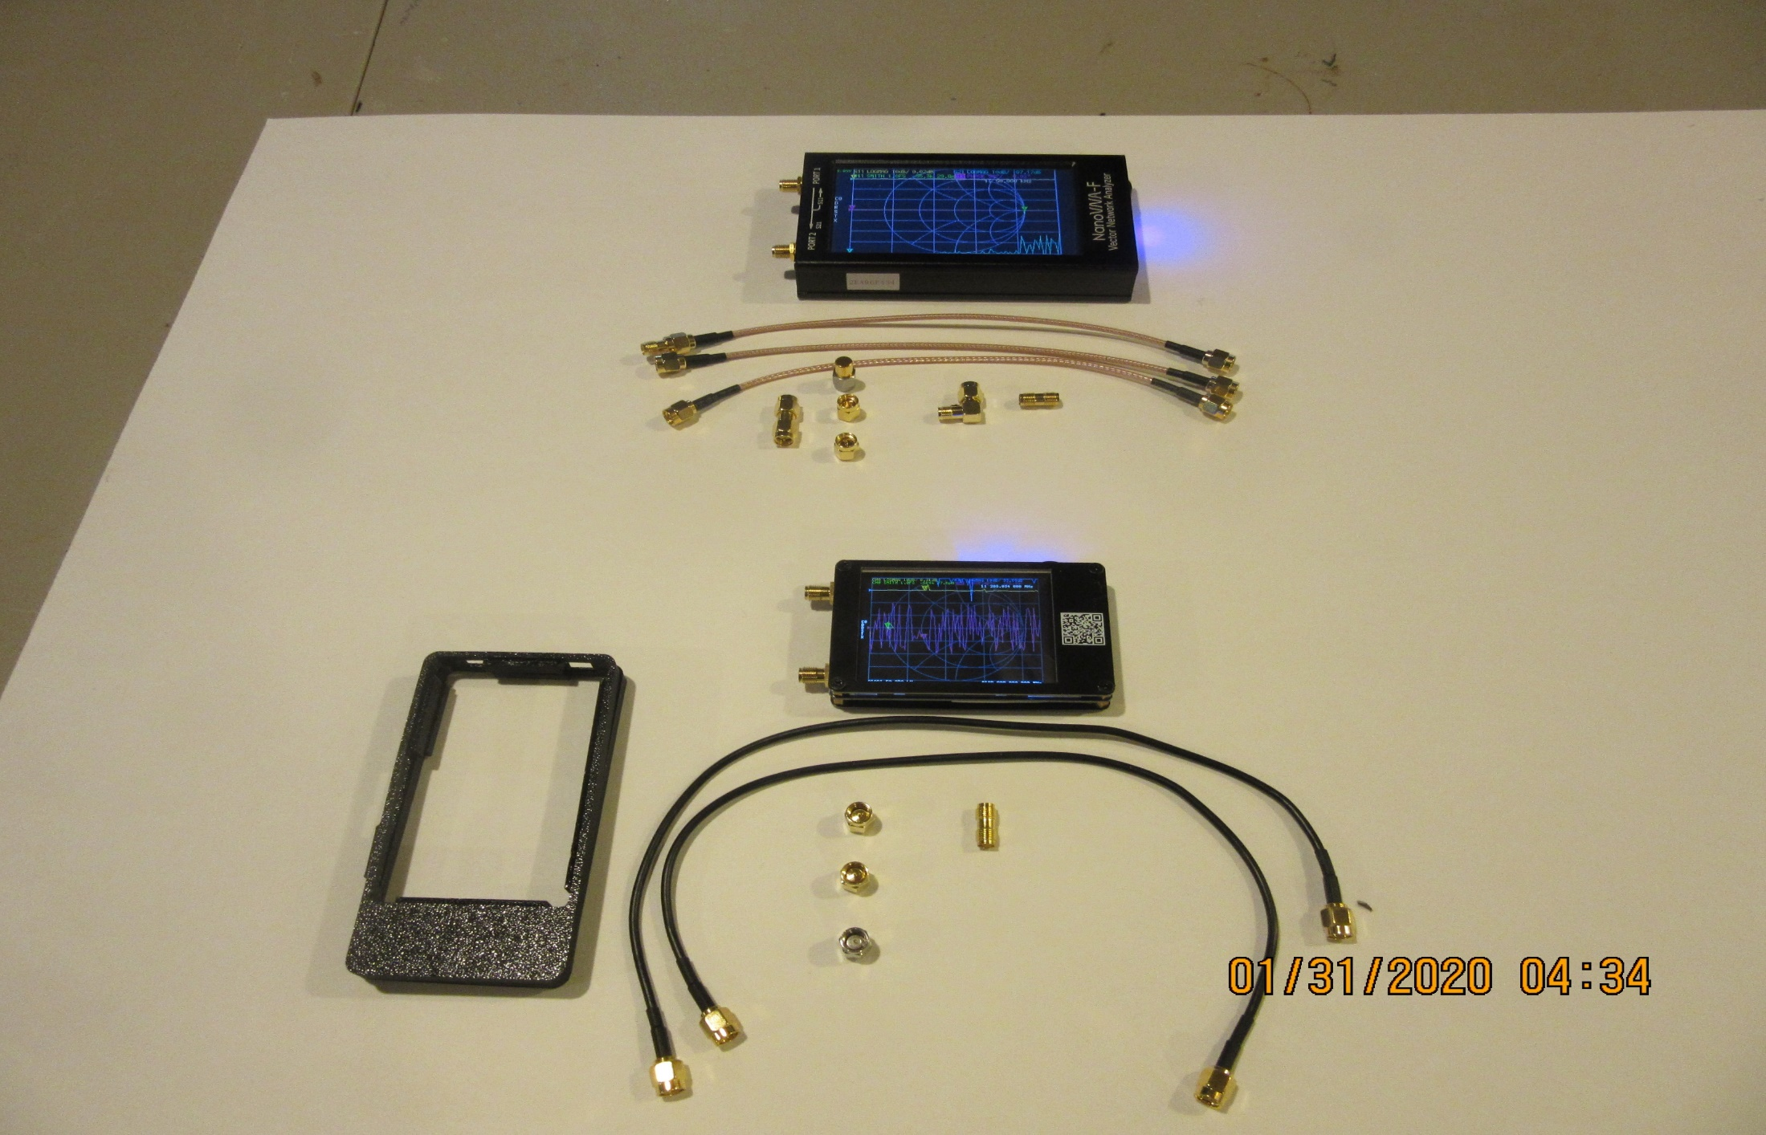
NanoVNA-F & NanoVNA
NanoVNA-F 4.3”
~$120 - $150
NanoVNA 2.8”
~$35 - $65

Slide 2
NanoVNA Overview
Low price precision measurement test equipment
Small portable PC connectable device
Requires calibration before using to ensure accuracy
Open source architecture – hardware and software
Uses include measuring:
Inductance
Complex antenna impedance
Chokes
Gain
Attenuation
Align filters
Measuring coax length and finding location of defects in a feedline

Slide 3
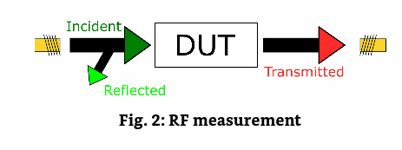
Navovna – General Description
NanoVNA is a vector network analyzer (not computer network)
Typical measurement range is 50Khz to 1.5Ghz (accuracy decreases with frequency)
Distinguishing features (from other test devices e.g. scaler antenna analyzers):
Measures amplitude and phase providing complex numbers
Real and imaginary elements of electrical features
Impedance as Z=R+jX instead of Z only (scalar antenna analyzers)
2 high-frequency ports/connectors allowing measurement of amplitude and phase as well as forward and reflected power.
Port 1 (CH0/TX) acts as the output of the incident signal as well as measurement port for the reflected signal
Port 2 (CH1/RX) receives the signal of a Device Under Test such as a filter
Scatter parameters/S-parameters – S11 and S21
S11 = measured at port 1, incident from port 1 (reflection)
S21 = measured at port 2, incident from port 1 (transmission)
Port 1
Port 2

Slide 4
Hardware versions and construction
High quality models and many cheaper clones
Sold with or without batteries, get one with the battery included
Sold with or without shielded ports (different from shielded case)
Cheaper models have inferior and fewer accessories, e.g. # of SMA connectors and coax leads (RG174 vs. RG316)
NanoVNA 2.8” screen – original marketed by Hugen enclosed in a protective plastic (3D printed) case
NanoVNA-F 4.3” – Deepelec sold through Aliexpress is a high quality offering with metal case and complete accessory package
Required calibration accessories include: short, open, load, thru connectors (SMA)

Slide 5
NanoVNA-F & NanoVNA
High quality models include metal enclosure and RG316 cables
NanoVNA-F 4.3”
~$120 - $140
NanoVNA 2.8”
~$35 - $65
3D printed case often extra $13

Slide 6
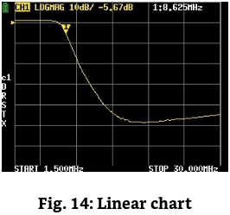
Using the NanoVNA and understanding its output Three Chart Types: Linear, Smith and Polar
Linear – used to display LOGMAG, PHASE, DELAY, SWR, LINEAR, REAL, IMAG, RESISTANCE AND REACTANCE
Always 9 horizontal lines on the plot of the hardware device

Slide 7
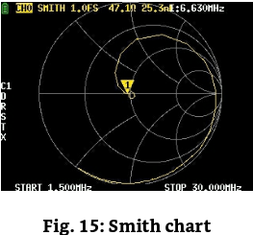
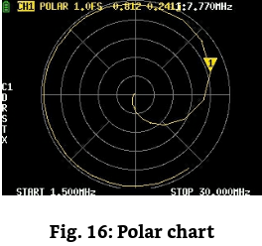
Using the NanoVNA and understanding its output Three Chart Types: Linear, Smith and Polar
Smith and Polar used to simultaneously portray complex impedance over frequency sweep – Smith and Polar provide different view of same data

Slide 8
Using the NanoVNA and understanding its output
Traces
Data is measured with traces - up to 4 (firmware dependent) represented with different colors (more when using PC interface and software)
Displayed as plots on the screen and as text on the left and top coded by color
Traces can be switched on and off and are associated with C11 or C21
Available formats of measurement data
LOGMAG: magnitude of signal in decibel relative to the incident signal
PHASE: phase of signal in degrees relative to the incident signal
DELAY: group delay versus frequency, typically in picoseconds or nanoseconds
SMITH: complex impedance at the selected port – real in ohms and imaginary in inductance or reactance, centered on 50 ohms
SWR/return loss
POLAR: complex reflection response
LINEAR: norm of the complex reflection response transmission coefficient
IMAG: imaginary part of the complex reflection response transmission coefficient
RESISTANCE: real part of the impedance in ohms
REACTANCE: imaginary part of the impedance in ohms

Slide 9
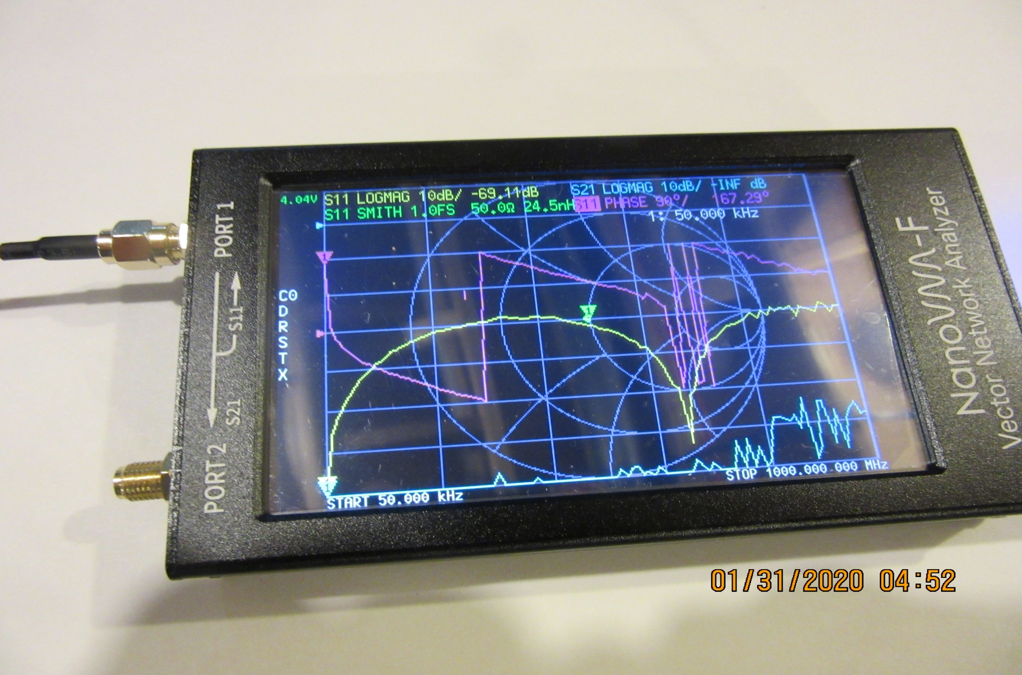
Traces of 50ohm load on 4” RG316 cable at 50kHz

Slide 10
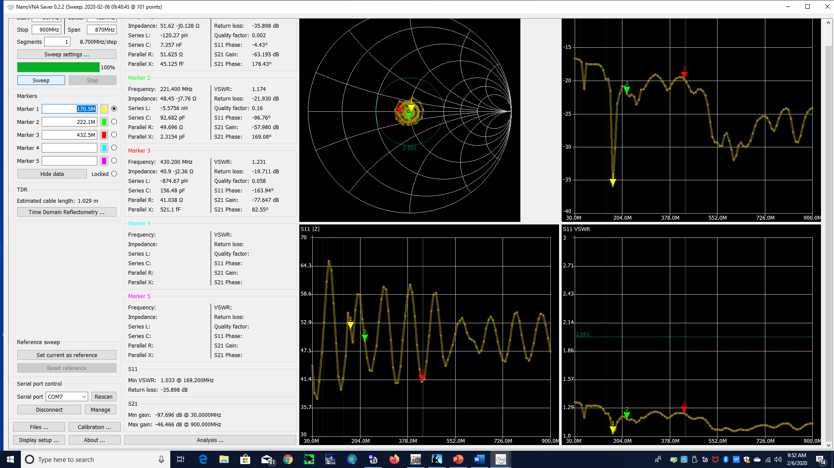
Markers - Set by the user for specific frequency data points and indicated on the screen by colored triangles (NanoVNA Saver 4 plot – 3 marker display example)
Return Loss
Complex Impedance
Analytical results provided for each marker that is set (Homebrew moxon for 1.25M)
Z - Impedance
VSWR
Z - Impedance

Slide 11
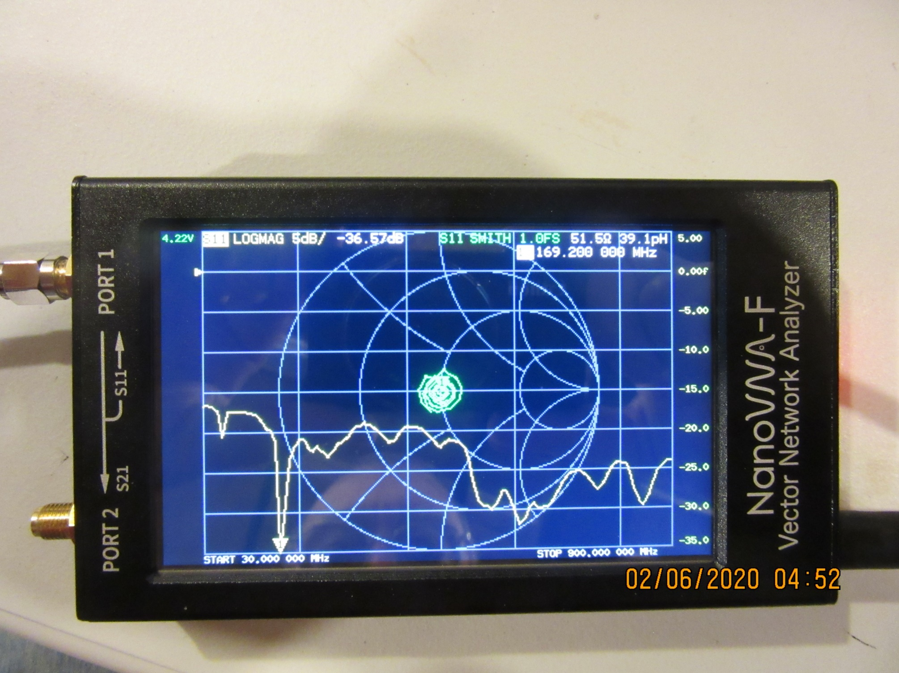
Traces and Markers as on Device

Slide 12
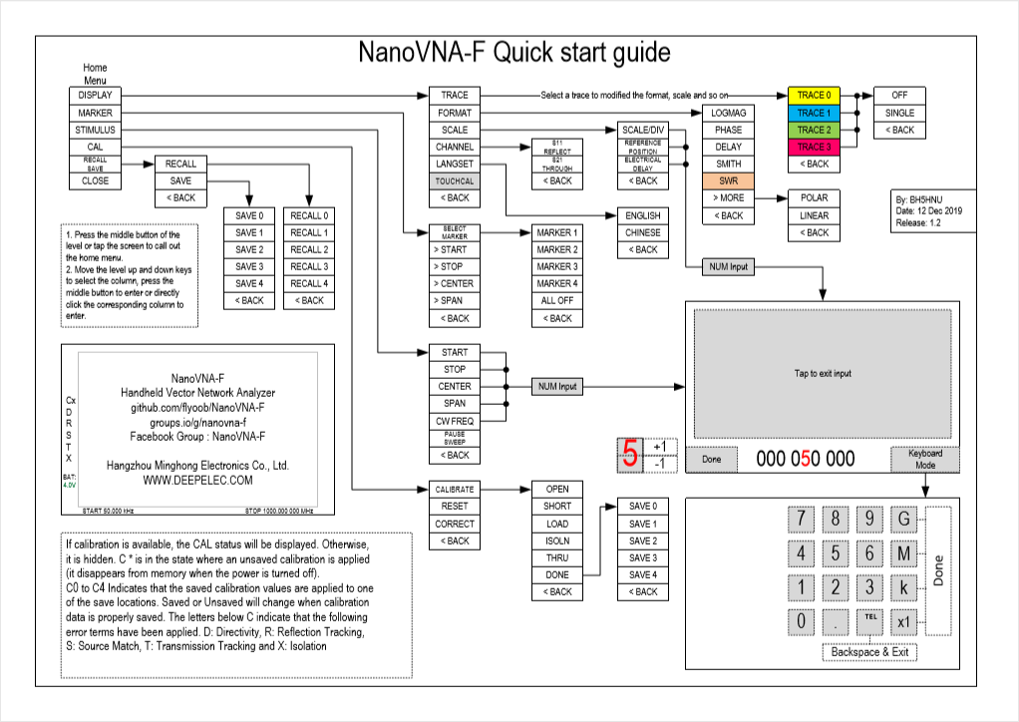
- Menu Structure

Slide 13
Calibration
“The NanoVNA is a very capable, high precision measurement device. But unlike some other instruments, it needs careful calibration before reliable measurement results can be expected. This is primarily due to the fact, that a VNA provides phase information, not only magnitudes. Bear in mind, that we are talking about a sensitivity of up to 70 dB. This is one in ten million!”
The phase of a signal is changed by many effects e.g.
Distance, type of feedline, connector type – which become more critical as frequency increases into VHF+ range
Two types of calibration – Full S21 (thru) and Partial S11 (reflected)
S11 – open, short, load
S21 – open, short, load, isolation, thru
5 calibration memories C0-C4, can be set for various uses/frequency ranges

Slide 14
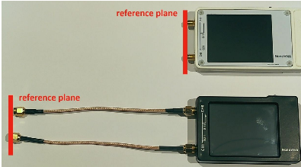
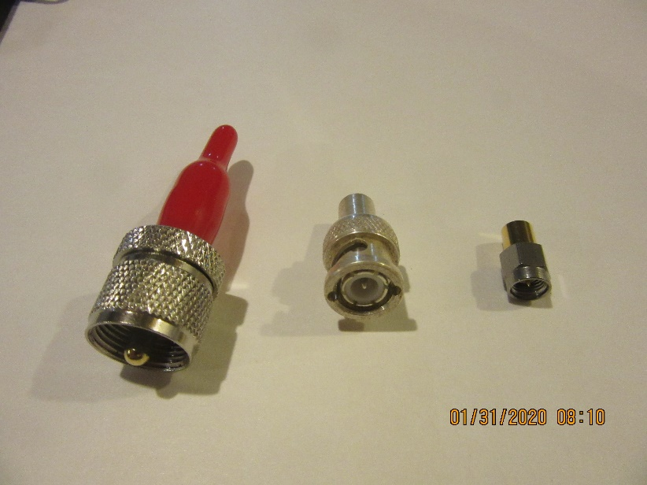
Calibration reference plane
Is the location where the DUT will be connected to the NanoVNA
It is very important, that the SOLT calibrators are fitted at the position of the reference plane during the calibration process – and ideally to the termination connector type!
Cable and connector effects are eliminated with proper reference plane calibration
Reference plane impacts become more significant as frequency increases (e.g. cable length)
Connector specific calibration standards

Slide 15
PC Software – NanoVNA Saver
This is probably the most comprehensive software currently available for the NanoVNA. As this software is based on Python it can be installed on Windows, Mac, and Linux.
Check it on GitHub, where you will find the latest release and instructions for installation.
The following illustrations are based on the NanoVNA Saver 0.2.2 release running on a Windows 10 computer.
Note: Once the NanoVNA is connected to the PC, a software calibration is required for accurate measurement, like the firmware calibration for the standalone device
1st the hardware unit should be calibrated
2nd the software is calibrated
Other software products include: NanoVNA-Web-Client, NanoVNASharp, TAPR VNA, Matlab/Labview

Slide 16
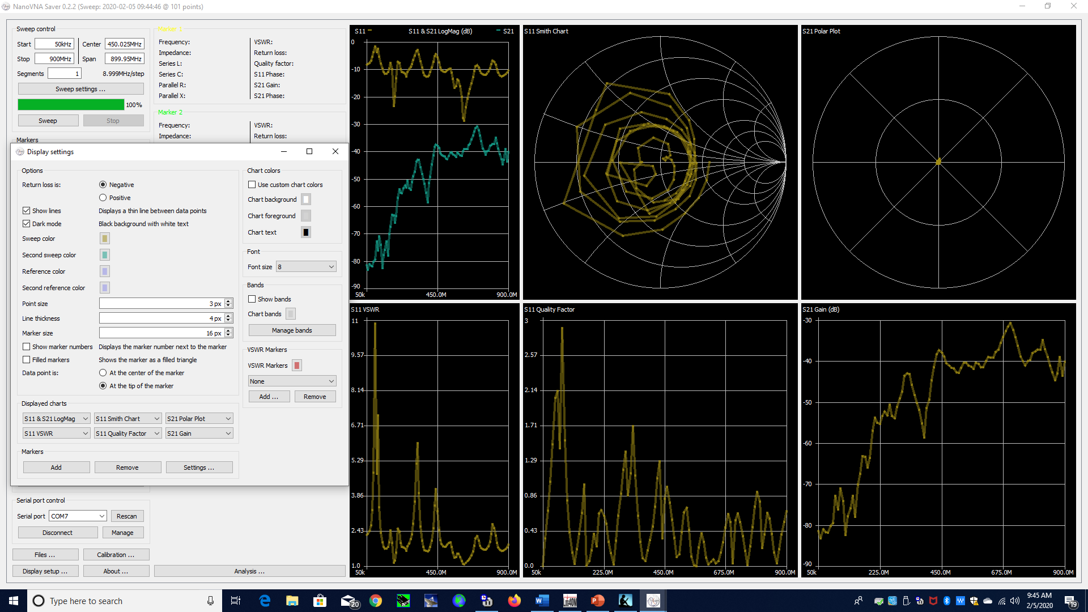
PC Software – NanoVNA Saver Cont. – Display Setup
Display settings
Allow up to 6 plots of 12 graph types
Allow additional markers
Sets line size and background
Display ham bands
Set VSWR limits

Slide 17
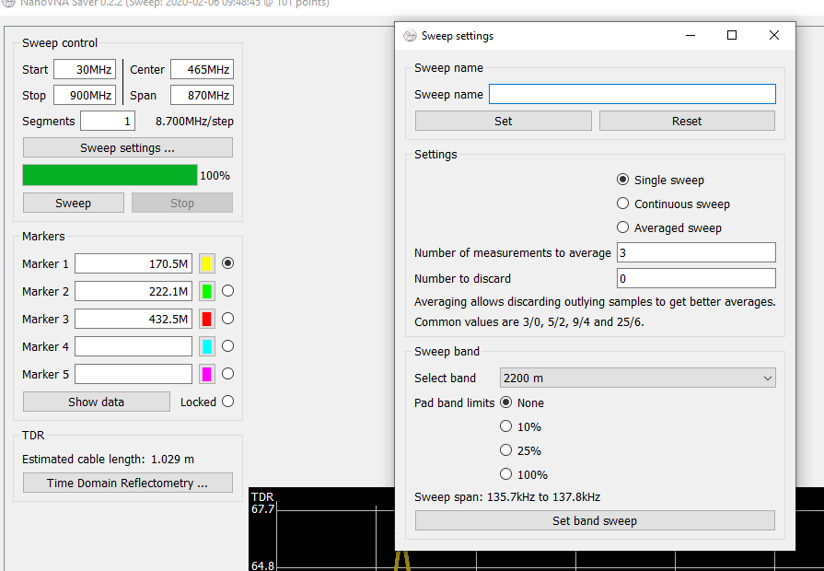
NanoVNA Saver Cont. – Sweep Control & Markers
Seep Control
Set frequency limits
Note - Always 101 measurements between limits
Reducing sweep limits increases granularity
Set single, continuous or average sweep
Set number of sweeps
Set number of measurements to discard (outliers)
Set degree to “pad” band limits
Name sweep for future use

Slide 18
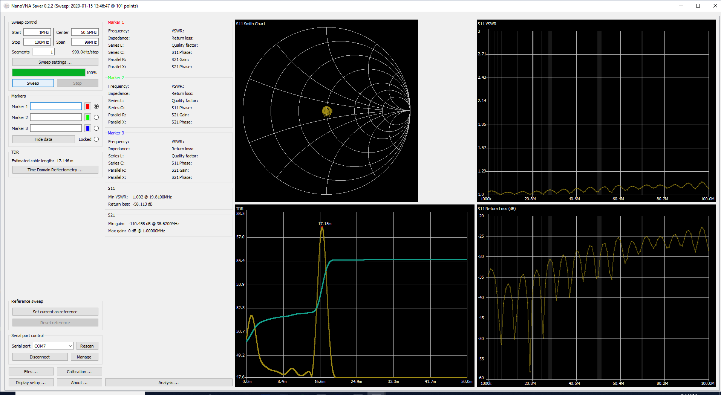
Analysis examples: TDR estimate of cable length with 50 ohm load (CH0 S11 plot)
Complex impedance
50 Ohms
VSWR
Cable length
56’ 3”
Return Loss

Slide 19
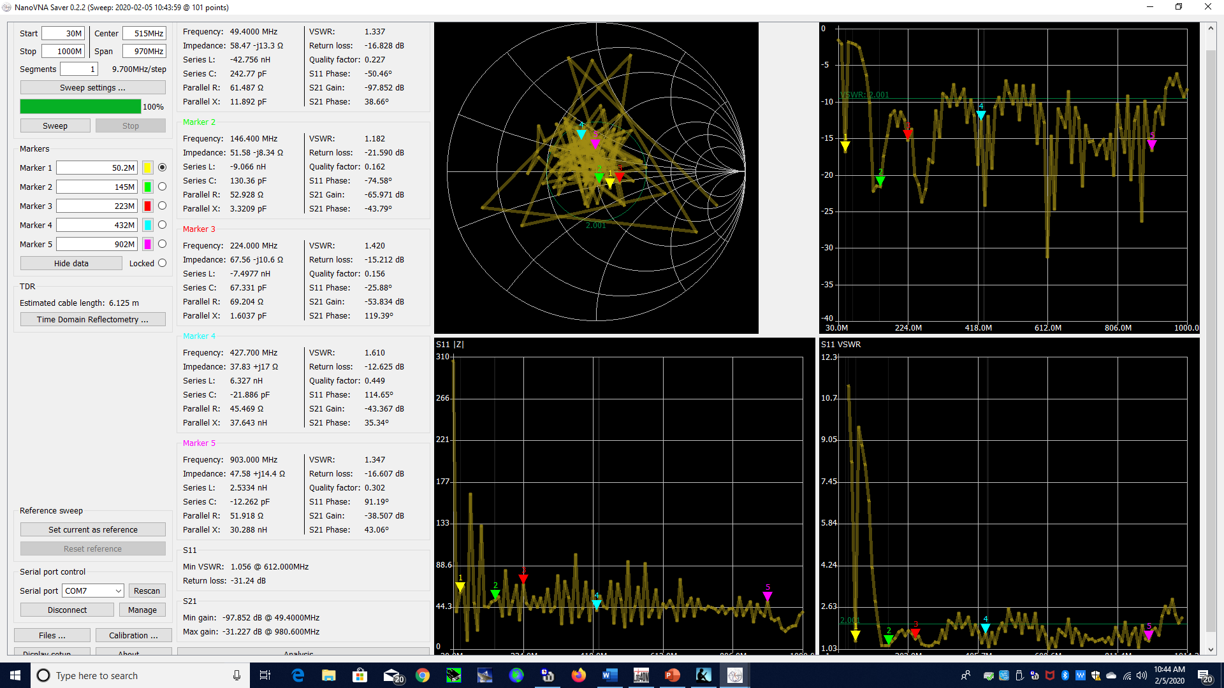
Analysis of a Disconne antenna – 30Mhz to 1Ghz (CH0 S11 plot)
Return Loss
Smith Cart – complex impedance
VSWR
Z - impedance

Slide 20
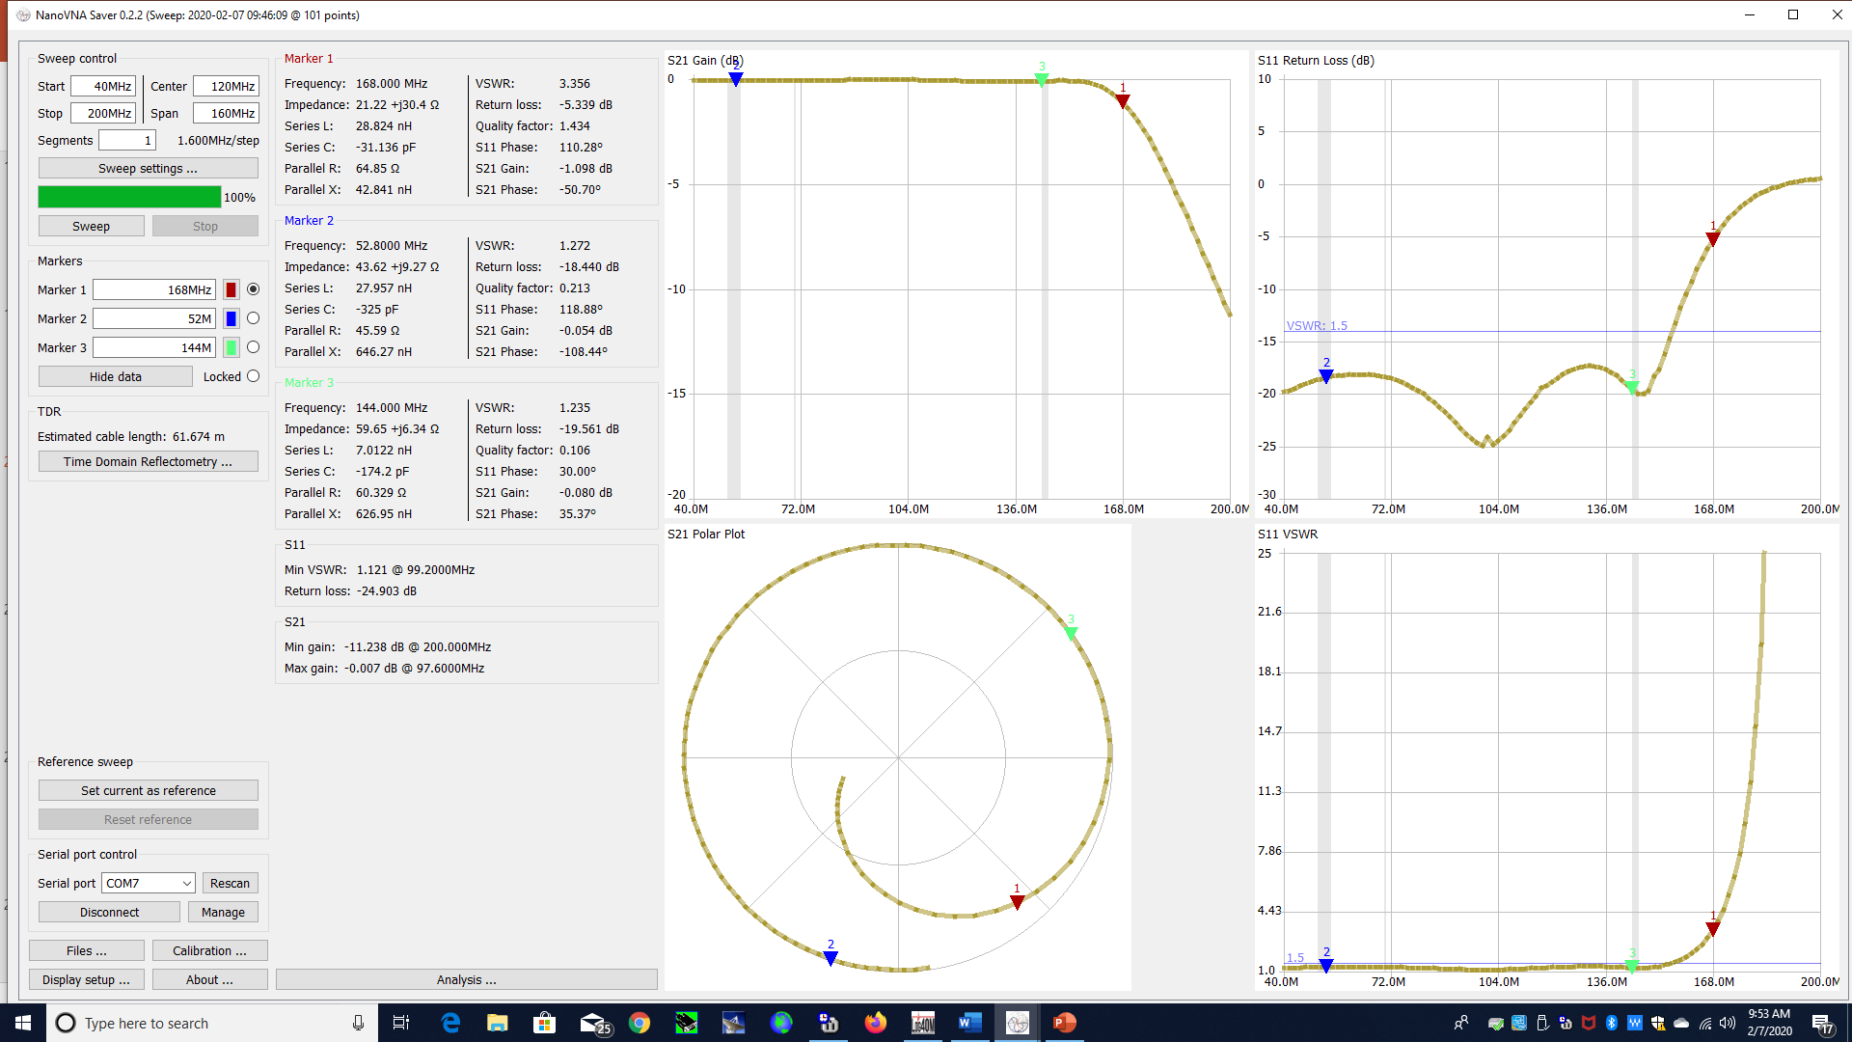
Analysis of a Low Pass Filter (CH1 S21) – What Ham Band is this designed for?
Return Loss
VSWR

Slide 21
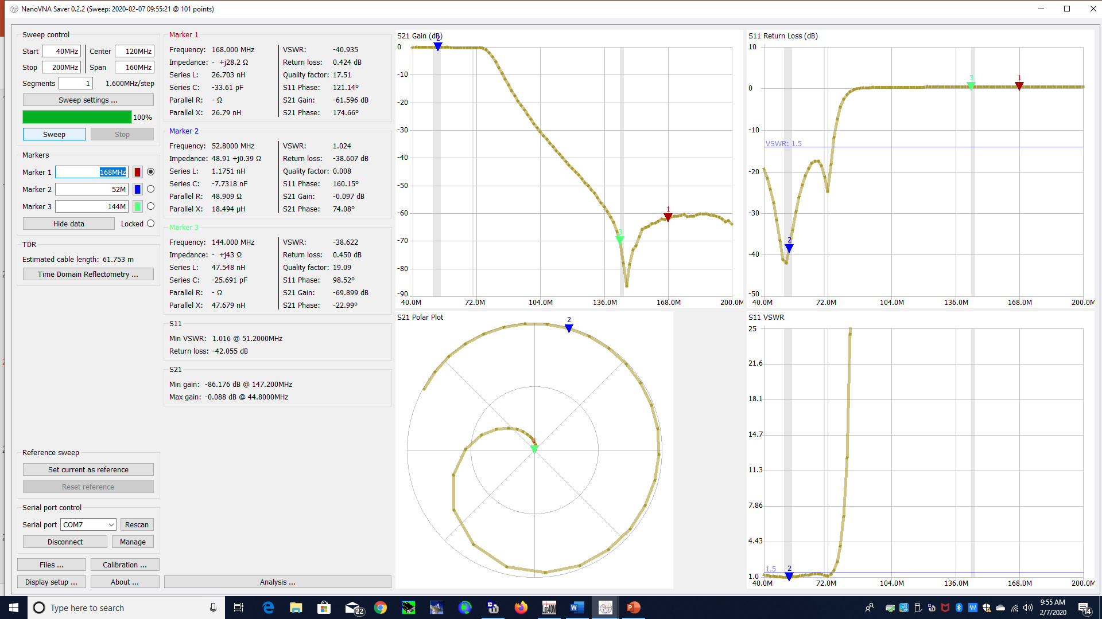
Analysis of a 2nd Low Pass Filter (CH1 S21) – What Ham Band is this designed for?
Return Loss
VSWR

Slide 22
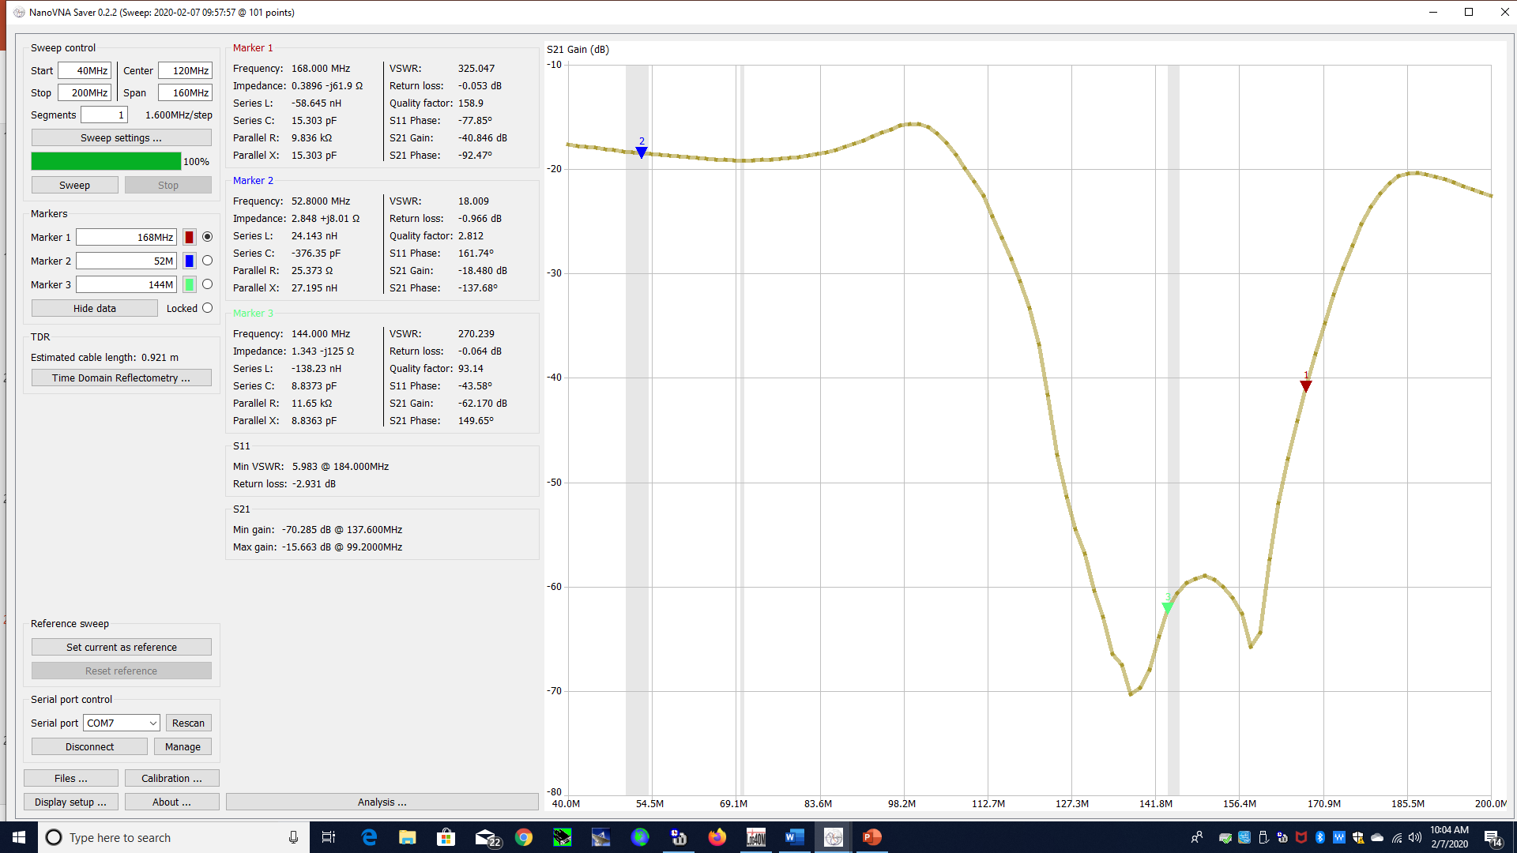
What is the Device Under Test?
Return Loss
VSWR

Slide 23
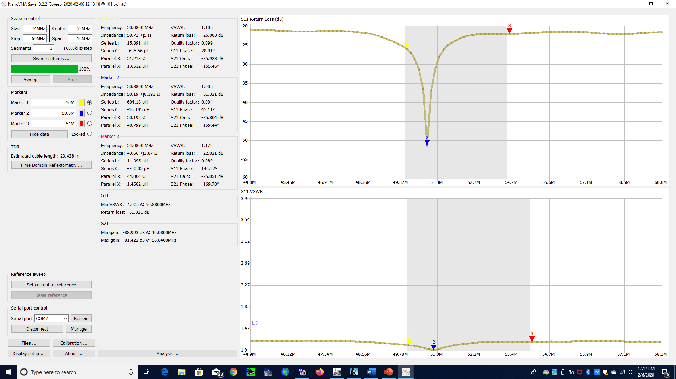
Analysis of a 6M Omni Angle
Return Loss
VSWR

Slide 24
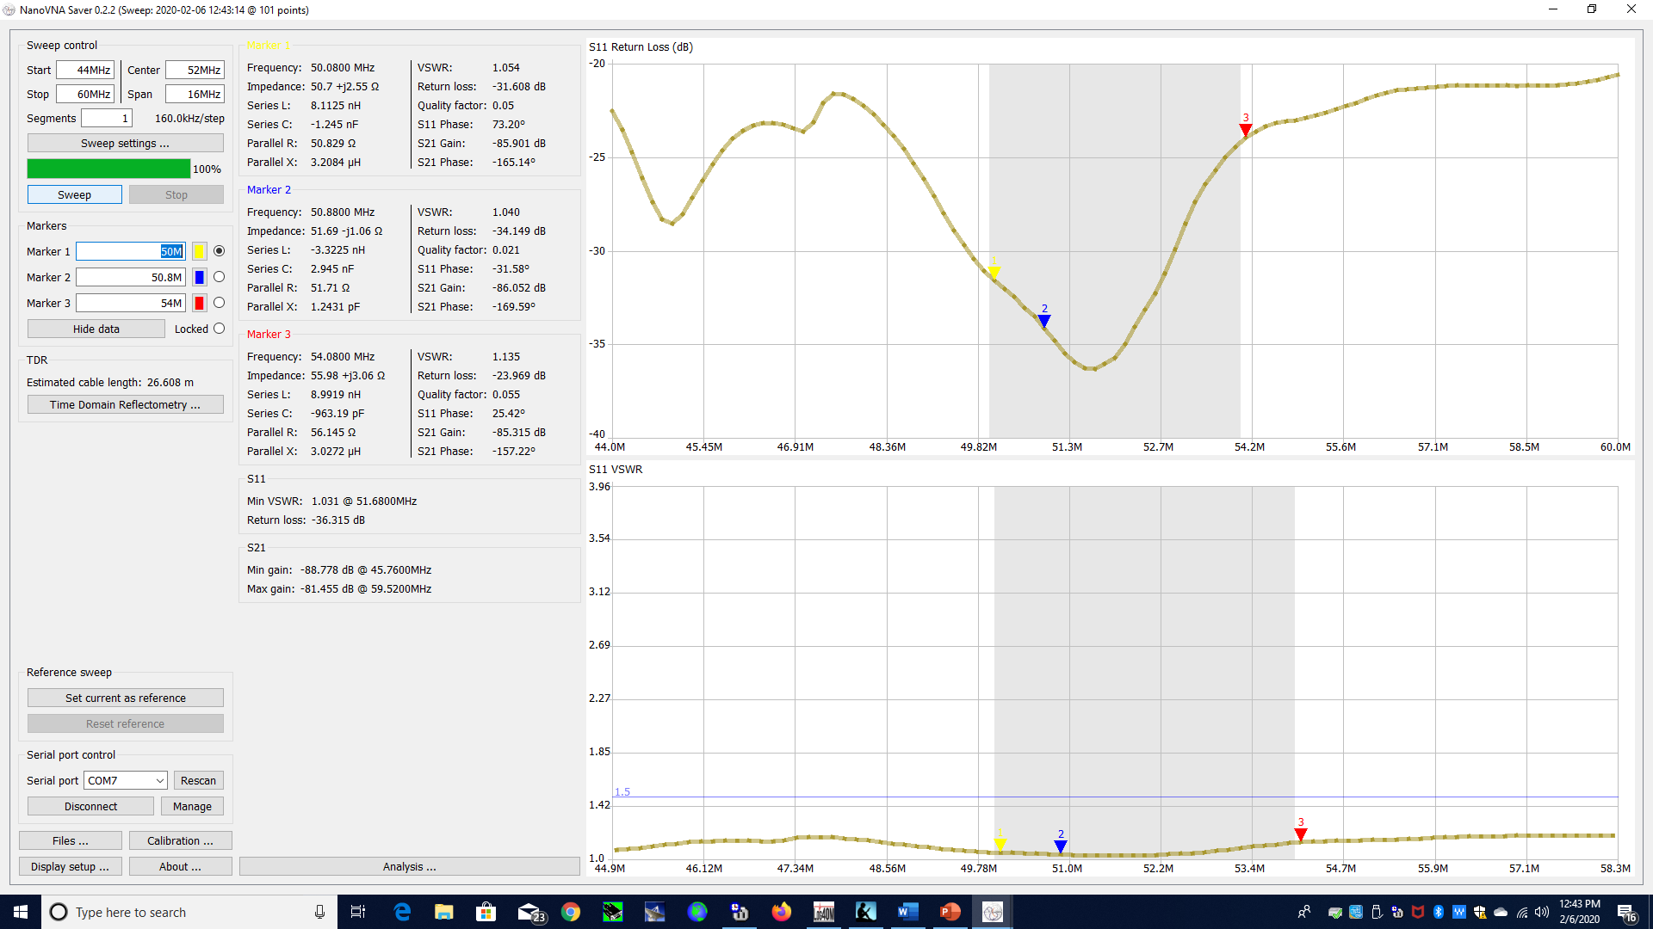
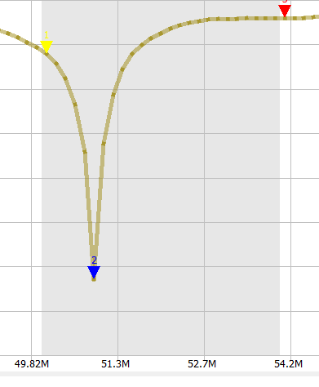
Analysis of a 6M 4 Element Yagi (with comparison to Omni Angle)
Return Loss
Memo:
Omni Angle
Return Loss Curve
VSWR

Slide 25
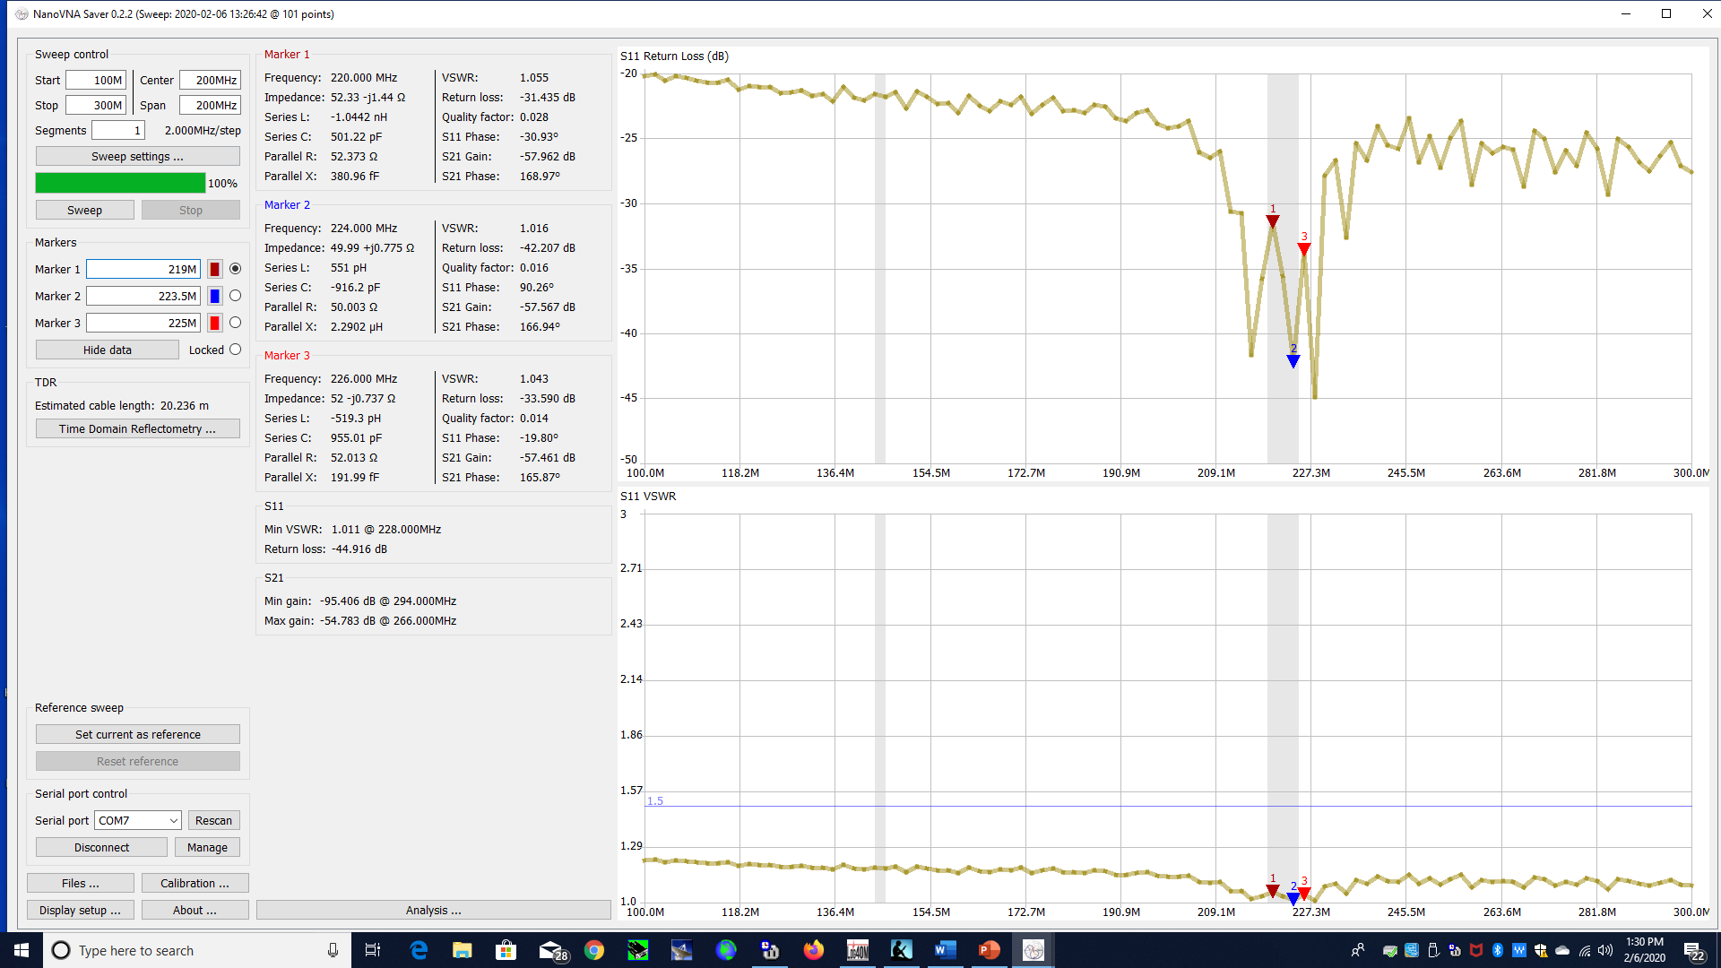
Analysis of a 1.25M (222Mhz) 5 Element Yage
Return Loss
VSWR

Slide 26
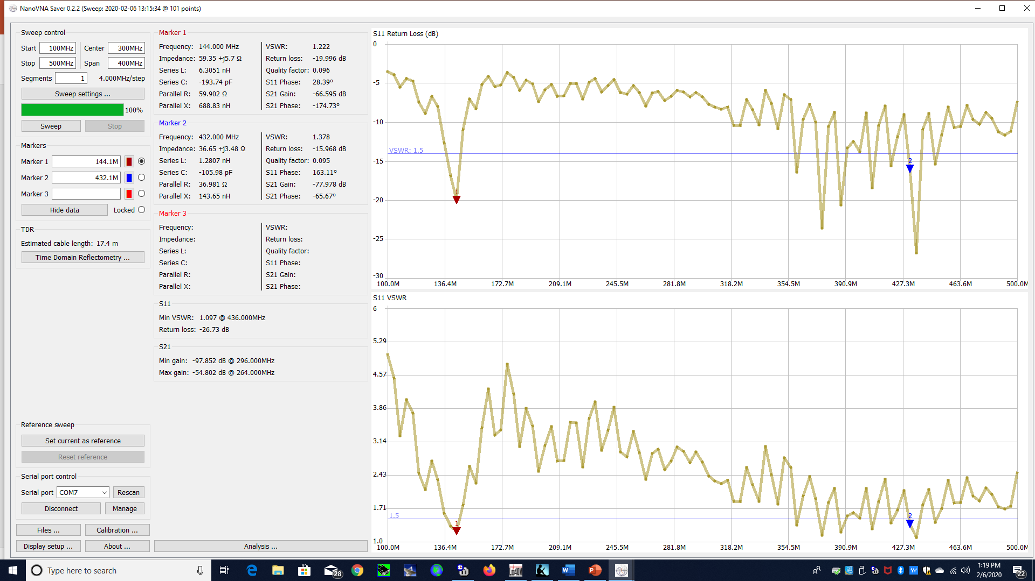
Analysis of a 2M/70cm Dual Band Yagi
Return Loss
VSWR

