Slide 1
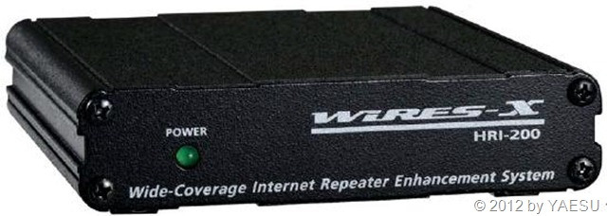
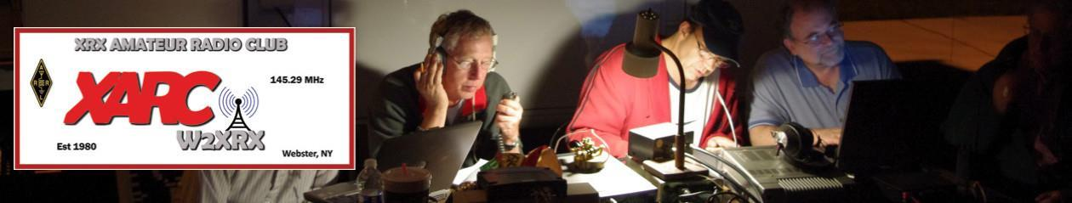


What the hell is it?
And why do I care?

Slide 2
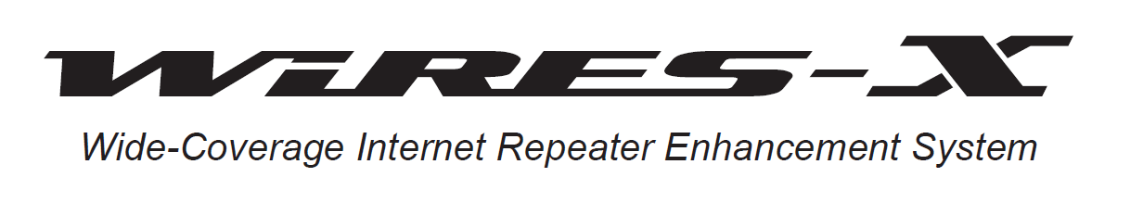
Acronym for:
Wide-coverage Internet Repeater Enhancement System
WIRES-X is digital communication developed by Yaesu to further the interest of the Amateur Radio Communication (and sell radios). It uses a form of VOIP (Voice over IP) to connect to distant Amateur Radio Stations utilizing the Internet. It supports the new C4FM Digital Communication mode. C4FM digital signals are repeated without deterioration of audio and data communications, and sent over the Internet to Amateur Radio Stations.
Older version (WIRES, Wires II), did not support C4FM/Fusion

Slide 3
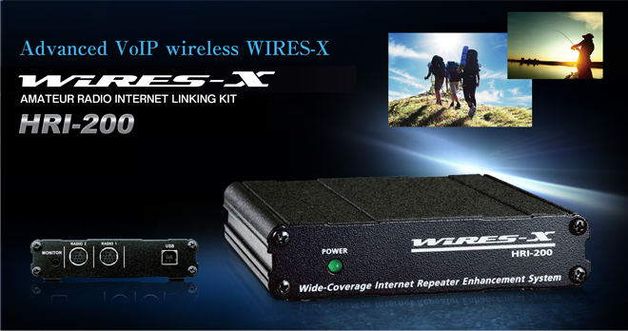

Slide 4
WIRES-X uses local Node (station connected to the Internet via a PC) as access points which repeats the communications of conventional Amateur Radio Stations (shown in Figure 1).
An amateur Radio operator calls a local Node’s radio which is connected to the Internet via a PC. The local Node radio relays the amateur’s call to the Internet via the PC. The PC relays the amateur call to another Node’s PC that is also connected to the Internet, then send it to the Node radio. Then local Node radio then relays the call to the receiving amateur radio station.

Slide 5
When the local Nodes are connected to each other via the Internet, Amateur Radio Stations all over the Globe can communicate with each other just by connecting a conventional station to the local Node (see Figure showing the relationship between Nodes on a WIRES X Global Network).

Slide 6
WIRES-X also supports digital communications which can transmit and receive digitized data, e.g. text, image and audio on the same Global Network. The WIRES-X Network extends the reach of an Amateur Station located in Webster to an Amateur Station located in Japan or somewhere in Europe. This can be accomplished by using just a hand held radio connecting to a local Node then onto the distant Node then to the destination amateur radio station.
Not a new idea – basically Yaesu’s implementation of similar tools (IRLP, Echolink, All-Star)
Doesn’t require external repeater controllers
Does not require a repeater. A node radio can be simplex. A simplex node could be connected via a room to a repeater to extend a repeaters range.
But it can be an easy method of repeater linking
Or a network of nodes could theoretically replace a repeater (may not be economically or logistically feasible)
Designed and optimized for their digital technology. Call signs, distances included with digital signal.

Slide 7
Terminology
Node
Radio (repeater or simplex) connected to the Internet via a PC, which repeats communications of a conventional amateur radio as an access point.
Local Node
This is a Node within the radio communication range of a conventional amateur radio station.
Analog Node
A Node that is a transceiver or repeater using a conventional FM format and can only repeat DTMF (Dual Tone Multi Frequencies) codes and analog audio transmission/receptions.
Digital Node
This is a Node which is a transceiver of repeater compatible with digital communications in C4FM (Continuous 4 Level FM) format. With this type of Node you can not only relay voice communications, but also text and image data transmissions. One can also repeat DMTF codes and audio transmissions/Receptions.

Slide 8
Terminology (con’t)
Conventional Amateur Station
This is a normal Amateur Radio station either an individual on a hand held radio, a mobile radio and a base station.
Room
This is a WIRES-X Network community space to which multiple Nodes can connect simultaneously, like the old telco party Line. This is a place where all amateur station can link to each other via local Node and communicate with each other. In addition to voice communication, one can chat with text messages on the PC used for the local Node.
WIRES-X user ID (node)
YAESU provide identification name with the WIRES-X node. Each node is assigned a DTMP ID (5-digit number, e.g. 11916) and user ID (alphanumeric e.g. WB7OEV) up to 10 digits in length provided. Knowing the ID of the node to connect to, you can transmit the DTMF ID code from the transceiver, specifying the node to connect to by searching by characters.

Slide 9
Terminology (con’t)
ID List
Nodes and room which currently operating WIRES-X. The list is stored on a Yaesu server and is distributed to nodes over the WIRES-X network. They are are listed and published on the Yaesu website. The website shows information such as IDs, the call sign and the operating frequency of the node.
WIRES-X Linked Repeater
A repeater connected to the WIRES-X network. A can be direct, or via an RF Link.

Slide 10
Local Node
The Local Node is a personal Amateur Radio Station (usually a base radio station) operating on a VHF/UHF simplex frequency, linked to a PC that’s connected the internet. This is what a Conventional Amateur Station uses to link to the WIRES-X Network.
The following are the base components of WIRES-X; this is a station that’s configured with the following;
  A Node Radio which a Radio that supports C4FM, such as Yaesu FTM 100 or the
  FTM 400.
  A HRI-200 WIRES-X Interface.
  A dedicated PC running Windows 7 or better
  WIRES-X PC Software Ver. 1.120 installed on the PC.
  An Internet Connection (6 MBps or better)
  Requires some open ports in Router
  Called a Gateway in the UK. (Requires specific license class to operate.)

Slide 11
Local Node Diagram
Figure shows a typical Local Node and its components. This is what it is needed to create the Local Node.
Start Video 1

Slide 12
WIRES-X Linked Fusion Repeaters
Using a repeater as a local node greatly increases the usable range
There are two methods of having a WIRES-X linked repeater:
  RF Linked – A remote station provides the link to the WIRES-X network and internet. The node radio is set to the repeater frequencies. Repeater transmissions are received by Node radio and put out over WIRES-X (K2AS node and/or K2AS room, or any other node/room that the K2AS node is connected to. Traffic received from Wires-X is transmitted by node radio on repeater input. Works fine, except for need for a dedicated Fusion radio. Best for remote repeater locations. Only one RF link per repeater, and should only be enabled or approved by the trustee.
  HRI-200 Connected at repeater site (Direct Connection)
    Requires internet connection
    Requires Windows PC running 24/7 at repeater site
    If repeater older than December 2015, requires repeater be sent back to Yaesu in Calif for a retrofit (free except shipping to CA as of now)

Slide 13
RF Linked Repeater to WIRES-X

Slide 14
Direct Connect Repeater

Slide 15
Control of a WIRES-X Node
The control operator of a local node station has ability to set various initial parameters via the HRI-200 setup:
  Access (open, closed, Group Mode)
  Analog or Digital
  Node radio frequencies (simplex or Fusion repeater)
  Power
  ID/Timers, etc
  (play video 2, then video 3)

Slide 16
User Control of a WIRES-X Node
All System Fusion equipped radios (except FTM-3200) allow users the ability to control a WIRES-X node (if access is allowed by control op)
Users can connect/disconnect to nodes/rooms
Holding the WIRES-X button (Dx) for 1 second – radio enters WIRES-X mode
Operation varies slightly depending on radio
Video shows a FTM-400DR controlling a node
(play video 4)

Slide 17
Issues
Not cheap. Digital requires new radio(s). Then again not outrageous either.
Communication over the internet can be challenging. Delays, packet loss sometimes require adjustments to operating practices (like pausing before and after talking)
Windows PC – for node operator. Can be a pain. Also if at a remote repeater site. Hamoperator.com has detailed instructions on how to set up PC to minimize hassle.
Two Analog nodes on FM repeaters can result in endless loop of kerchunking. May be inherent problem or fixed by firmware.

Slide 18
DV4MINI/Shark RF vs. WIRES-X
DV4MINI and Shark RF provide similar functions and are compatible with Fusion, but operate on different networks (DV4MINI requires computer, Shark RF does not)
Both have small built-in 440Mhz radios
Both are European designed. Lower cost overall.
WIRES-X Network is access controlled. Yaesu assigns IDs based on registering an HRI-200 box.
DV4MINI network is based off DMR infrastructure and servers. I don’t know technical details, but essentially they aren’t directly compatible.
Gateways can be established to an individual room or node – the Monday night MN-WIS net has many DV4MINI check-ins.
DV4MINI and Shark RF are great for sitting in your family room with an HT and talking to hams any where in the world without needing another radio. Range is very limited (though can be improved with external antennas).

Slide 19
DR-2X Repeater
Yaesu is planning a new Fusion Repeater
  DRDT – Dual Receive/Dual Transmit
  Multi-Site Repeater Link
  More robust Final power amp stage (50 watt not discouraged)
  Enhanced Group Monitor
  News Station function – announcements, messages (optional module)
They have stated the DR-1X will continue being produced

Slide 20
More Info / Links
Fusion Help - (http://www.hamoperator.com/Hamoperator/Fusion_Help.html
Fusion Live – map of Wires-X Nodes –
https://fusionlive.net/
Yaesu Wires-X Info - http://systemfusion.yaesu.com/wires-x/
Wires-X ID List - https://www.yaesu.com/jp/en/wires-x/id/id_usa.php
Wires-X Yahoogroups - https://groups.yahoo.com/neo/groups/wires-x/info

