Slide 1
The OCFD antenna
A “build to spec” approach

Slide 2
What is it?
Half wave length antenna
Fed at a high impedance point with a N:1 balun
To obtain reasonable impedance matches
at multiple harmonics

Slide 3
Why bother with it?
Simple single wire antenna
Provides multi-band operation
Easily customized to meet specific requirements

Slide 4
How to build it?
Define goals
Adjust variables
  length
  feed point
  impedance matching
  shape
Simulate
Iterate

Slide 5
My Initial goals
No special ground system
Coax feed line from transmitter
Install along fence line
Very stable supports - minimize fatigue
Total new cost: $200 to $300...
Must: 40, 30, 20, 15 meter bands
minimal antenna tuner requirements
optimize for CW
Workable: 80, 17 and 10
Very Stealth
single wire -- black insulated
no traps, etc
near end fed -- at main support
Take advantage of natural "camouflage"

Slide 6
This Eliminates many antennas
loaded antennas
end fed antennas
center fed dipoles
trap antennas
doublets
verticals
fan dipoles
towers & beams

Slide 7
So, what’s left???
OCFD / near end-fed
Cut for low end of 80 meter band
Fed at 15 to 30% point
N:1 balun at feed point
Coax from transmitter

Slide 8
Design approach
Select Fundamental
  Lowest band of interest
  Harmonics of interest
Select the feed point
  Avoid zero current / high SWR
  Use Balun
    Minimize unbalanced currents in feed line
    To optimize driving point impedance
Simulate and iterate

Slide 9
Consider current plots
At resonance, Standing Wave currents are zero at end points
First and third harmonics have current peaks
Even harmonics have zero current.
Center fed antennas have very high impedances for even harmonics…

Slide 10
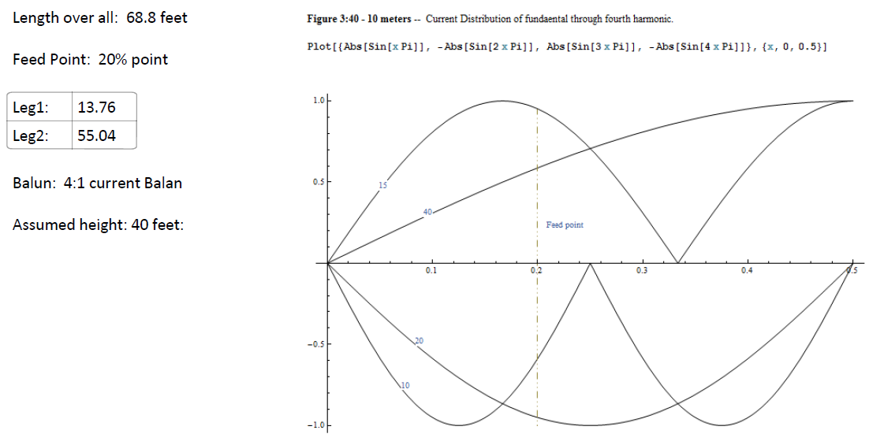
Field Day -- 40

Slide 11
Field Day – 40 SWR Plot

Slide 12
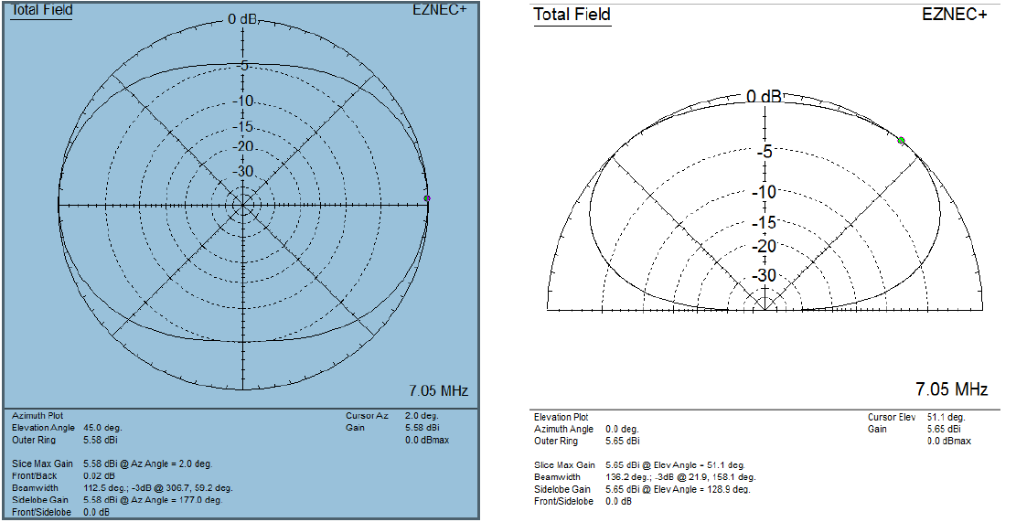
FD-40 on 40 M

Slide 13
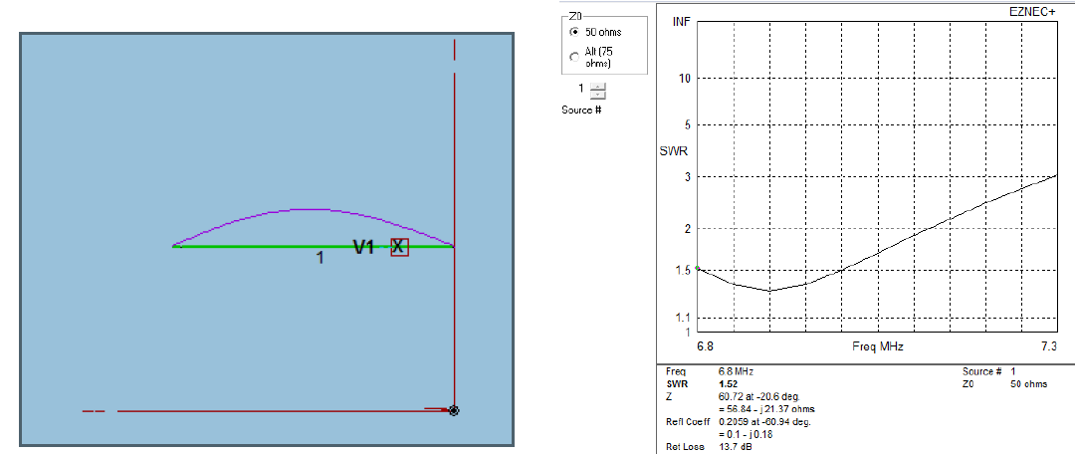
FD-40 on 40 meters

Slide 14
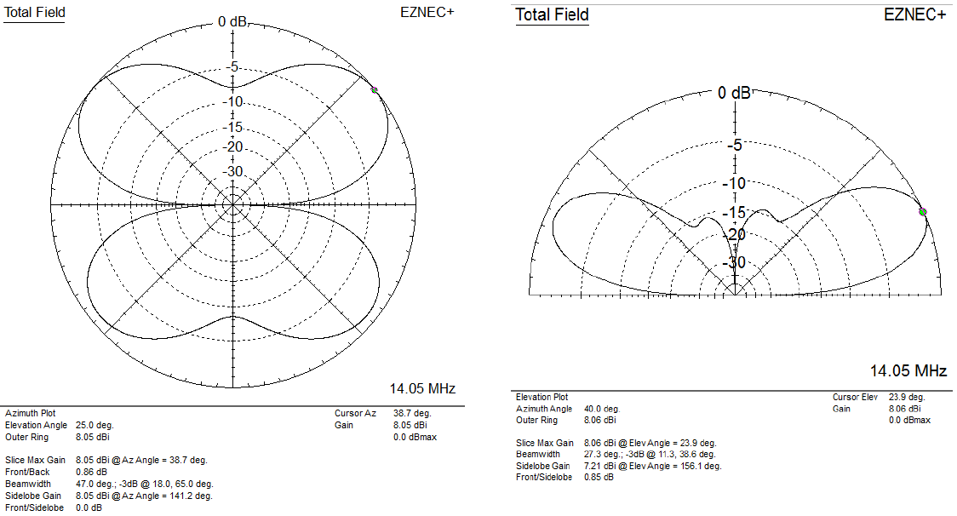
FD-40 on 20M

Slide 15
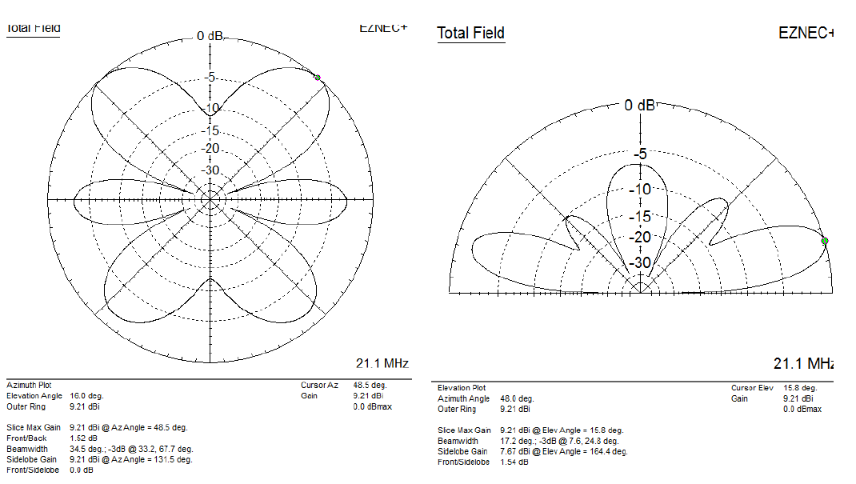
FD-40 on 15M

Slide 16
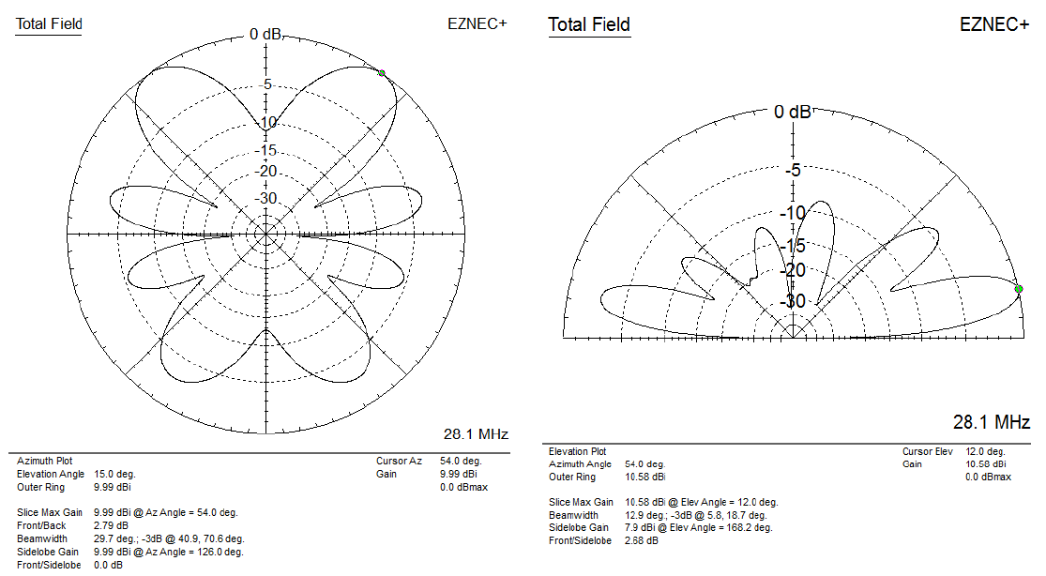
FD-40 on 10M

Slide 17
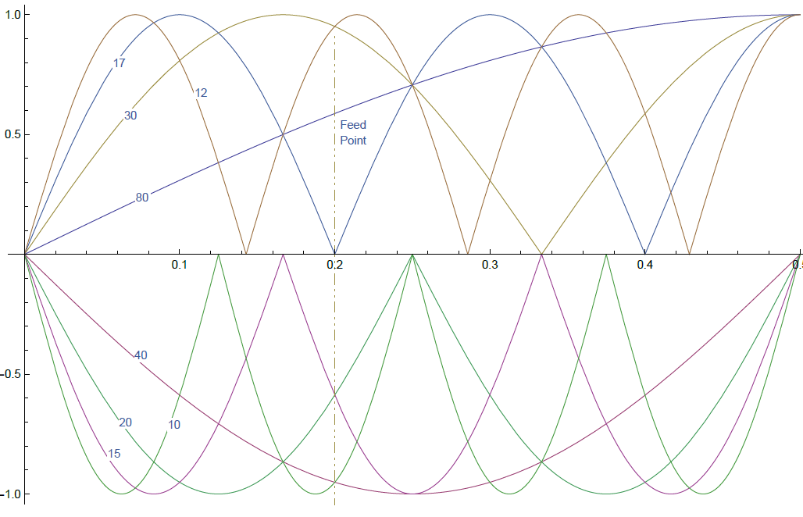
Now consider 80 – 10 meters
Take absolute value
Invert even harmonics
Avoid zero current
Use 4:1 Balun…
Simulate to find best set of options

Slide 18
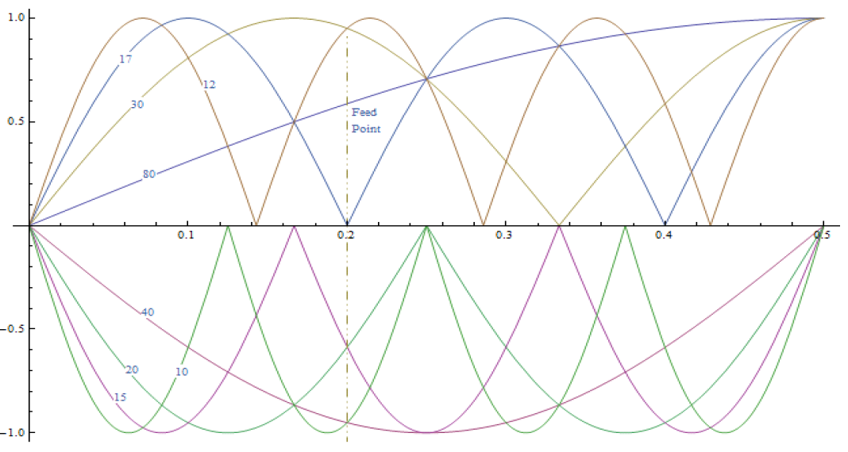
Ned OCFD - 80

Slide 19
Ned OCFD – 80 SWR Plot

Slide 20
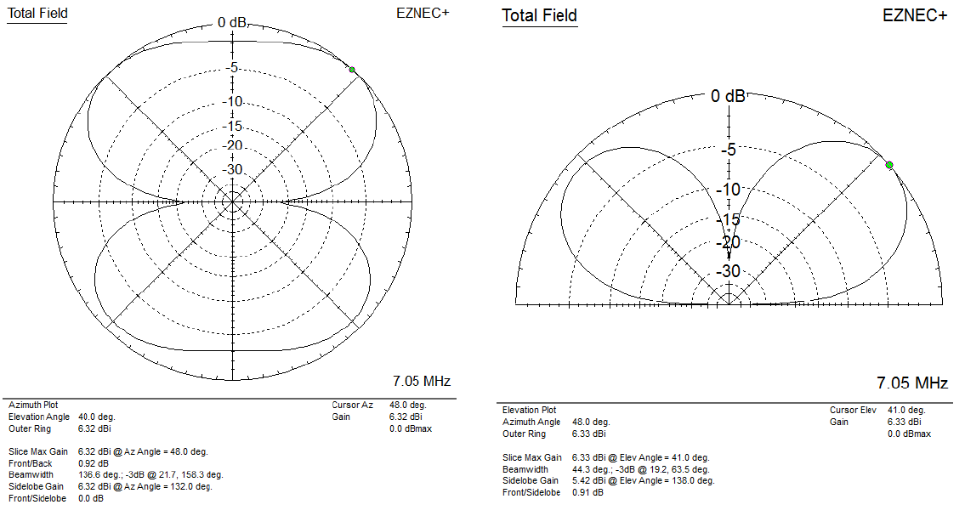
Ned OCFDP – 80 on 40 M

Slide 21
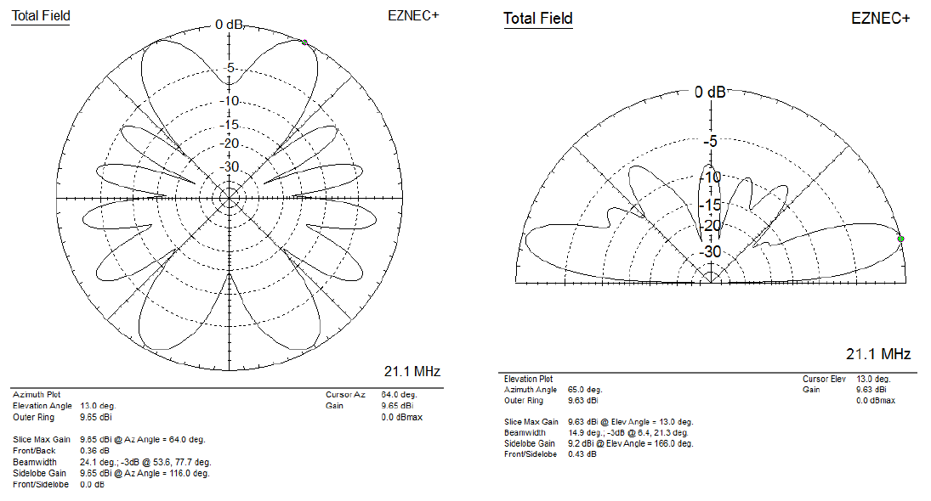
Ned OCFD – 80 on 15M

Slide 22
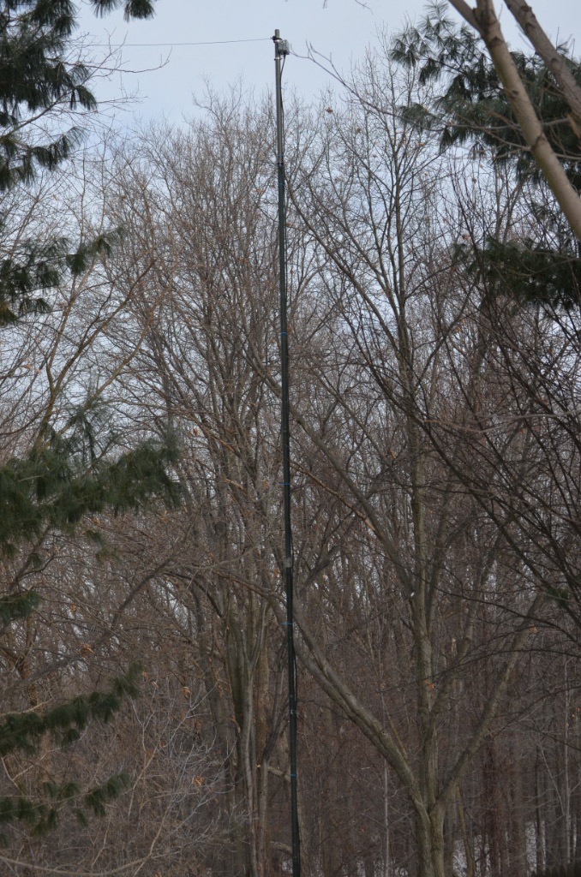
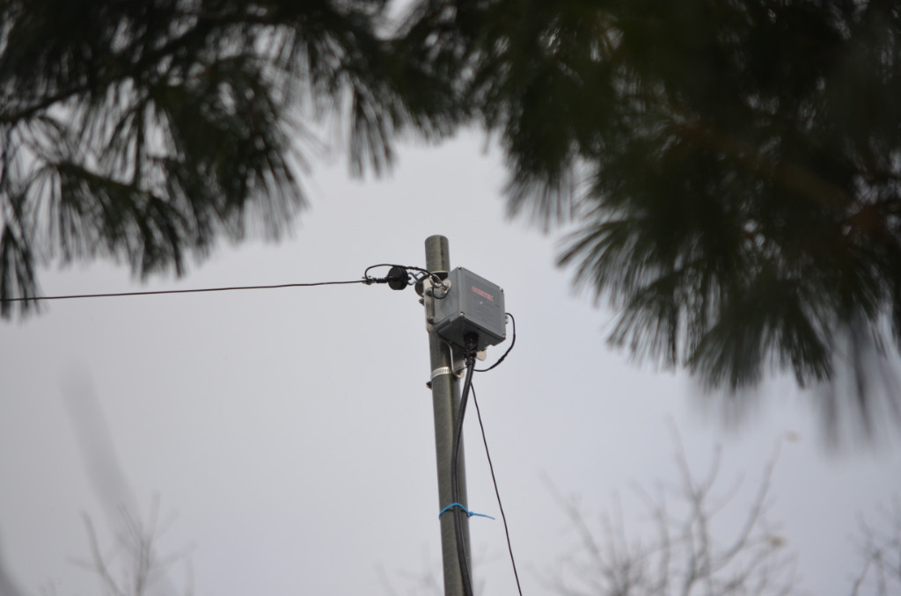
Ned OCFD – 80 Installation

Slide 23
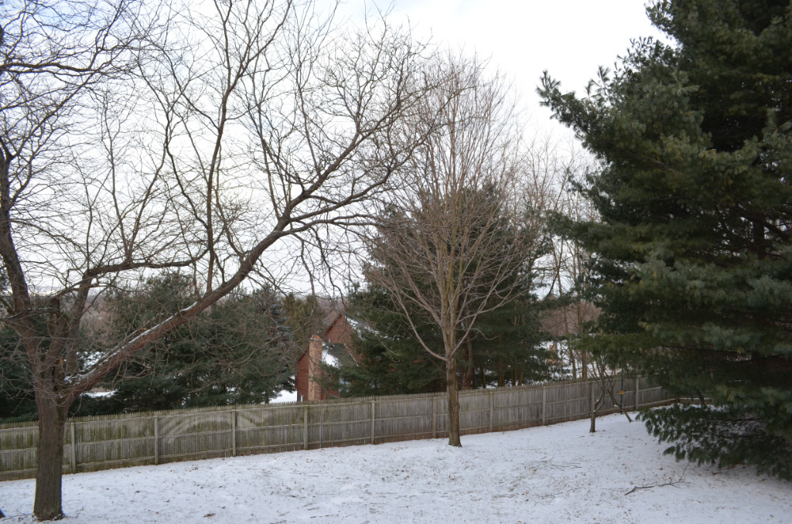
Ned OCFD – 80 Installation

Slide 24
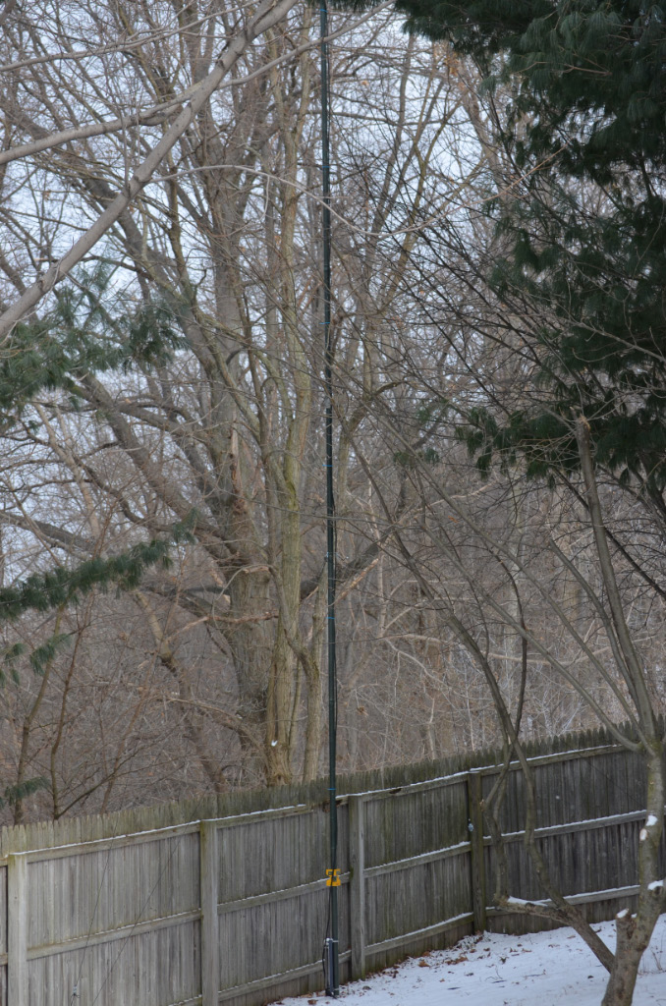
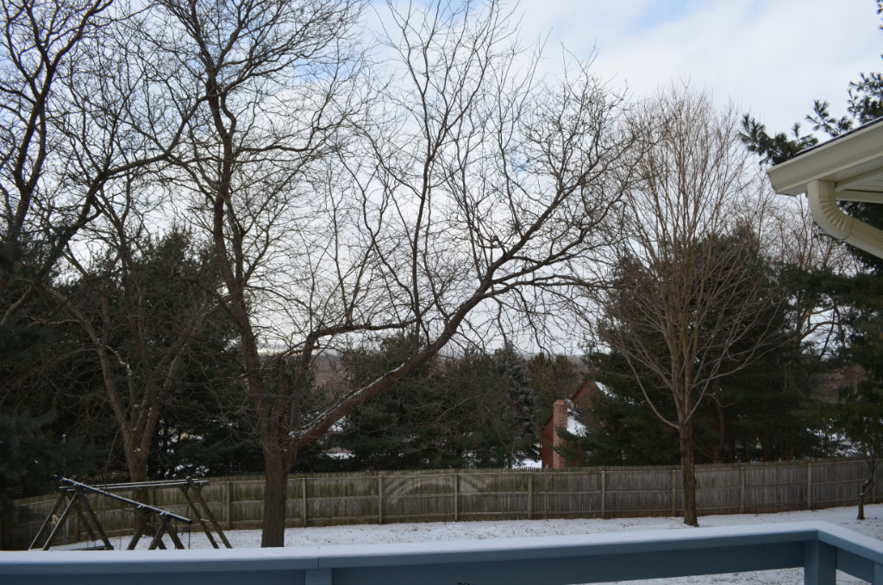
Ned OCFD – 80 Installation

Slide 25
OCFD build Chart
 | Ned OCFD - 80 | K2OID OCFD-80 | FD-40
Overall Length | 137.5 feet | 137.5 Feet | 68.8 feet
Feed Point (%) | 20% | 25% | 20%
Balun | 4:1 | 4:1 | 4:1
Coverage | 80-40-30-20-15-12-10 | 80-40-30-17-15-12 | 40-20-15-10

